Slide 1
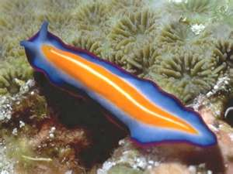
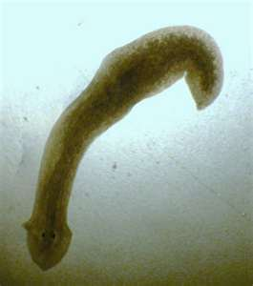
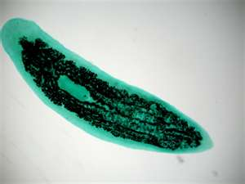
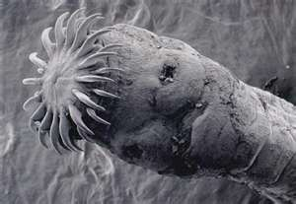
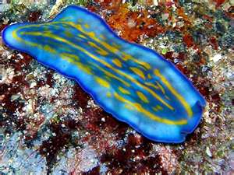
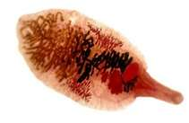
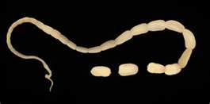
Phylum Platyhelminthes

Slide 2
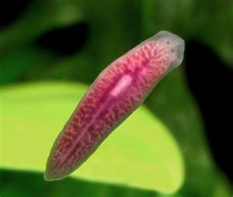
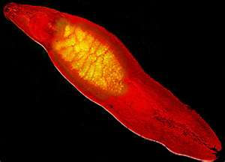
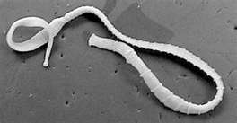
Flatworms
__________________________________________________________
  Ex: planaria, tapeworms, flukes
__________________________________________________________
___________________________________________

Slide 3
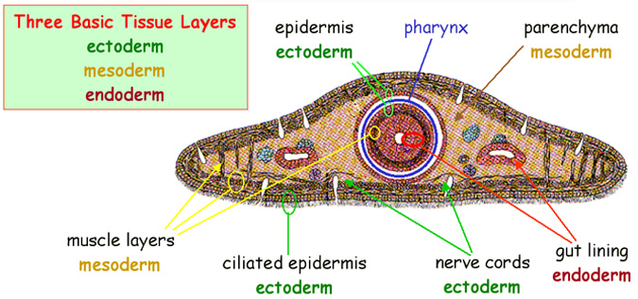
Evolutionary Advances
___________________
  _________________ located between _______________ and _____________
__________________
____________________
Simple organs
__________________
  No internal body cavity other than digestive tube

Slide 4
Systems
Feeding
  Free-living (Planaria)
    ____________________________
    ________________________with _______opening at the end of a _______________________on the mid-ventral side
    GVC is ___________________
    _________________

Slide 5
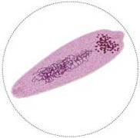
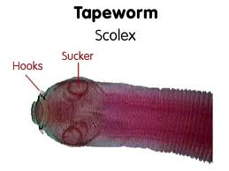
Systems
Feeding
  _________________
    Feed on host tissue
    _________________________________
    No anus
  Flukes have GVC with one opening at the end of a muscular pharynx
  Tapeworms __________________ _____________________________

Slide 6
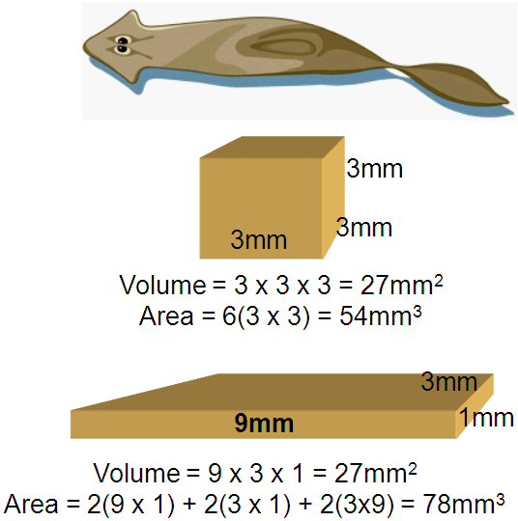
Systems
Respiration
  By __________________
Circulation
  By __________________
______________________________________
  ______________________________________

Slide 7
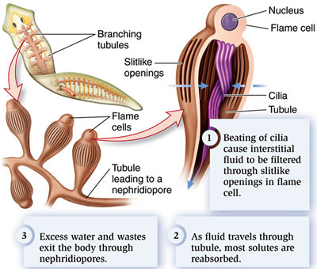
Systems
Excretion
  By _______________ into ______________ __________________
  ____________pump water and waste out of the body via ____________________________________

Slide 8
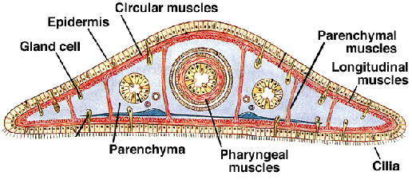
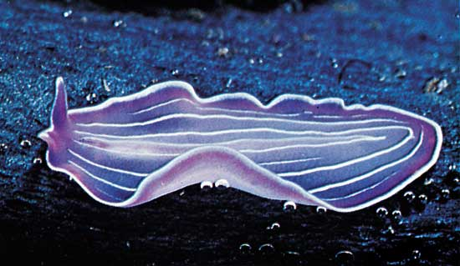
Systems
Movement
  ___________________ flatworms use ______ on ________________ to swim
  _______________ and ____________ muscle allow for __________ _______________
  Hydrostatic skeleton

Slide 9
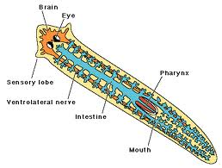
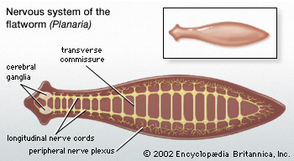
Systems
Nervous System
  Parasitic flatworms ___
  ______________________________________________
  Free-living
    _______________________
    Paired _________________ _______________________
    Various senses including _________ and __________

Slide 10
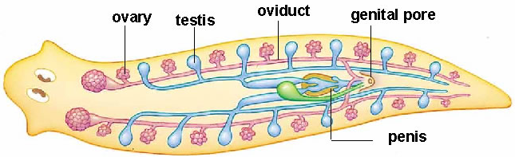
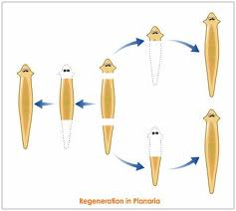
Systems
Reproduction
  Free-living
    Asexual:
      __________________________
    Sexual:
      ____________________
      _________________________
      Embryos emerge as juveniles resembling adults.

Slide 11
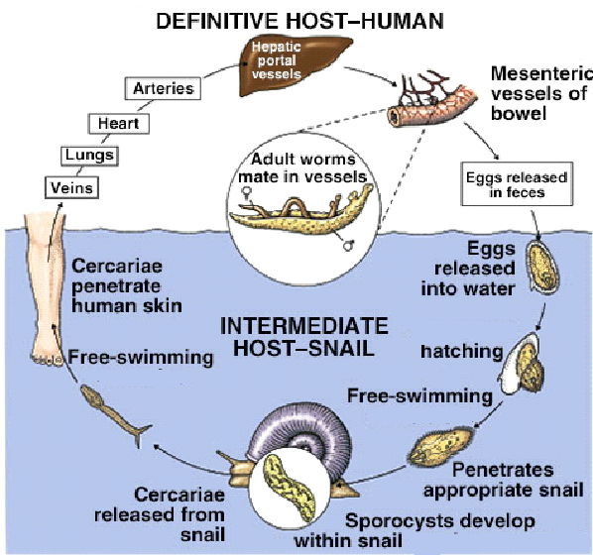
Systems
Reproduction
  Parasitic
    Flukes:
      Sexual only
      Complex life cycles involving more than one host
      Large number of young

Slide 12
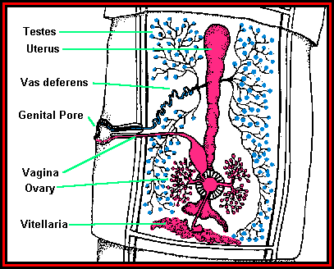
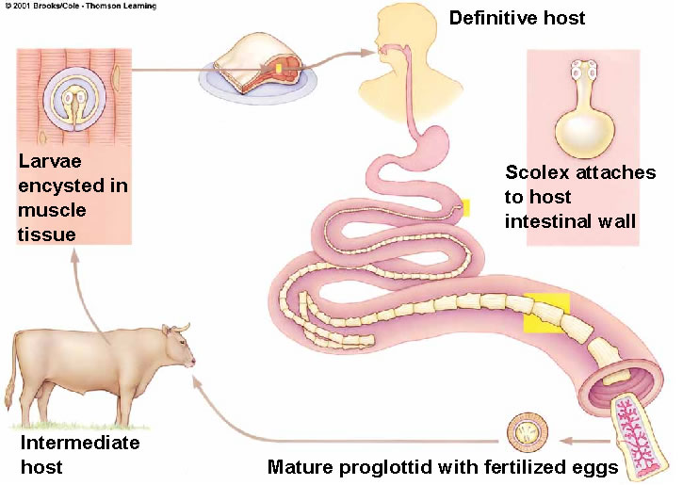
Systems
Reproduction
  Parasitic
    Tapeworms:
      ___________________
      ___________________
      Reproductive segments called _______________
      Large number of young
      Youngest proglottids near _______________

Slide 13
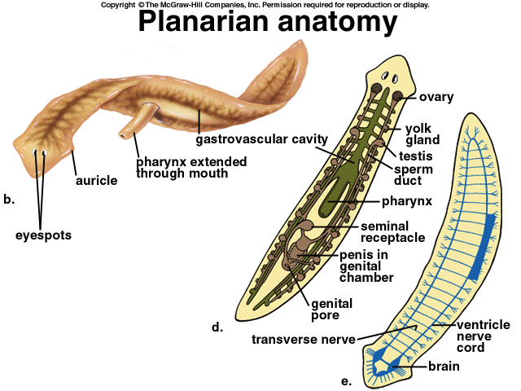
Organization
Platyhelminthes is a phylum composed of three classes of flatworms.
Class ________________
  Free-living
  Ciliated
  Ex: Planaria

Slide 14
Organization
Class ________________
  Parasitic
  Complex life cycles
  Ex: Flukes
The Flukes

Slide 15
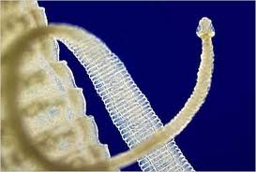
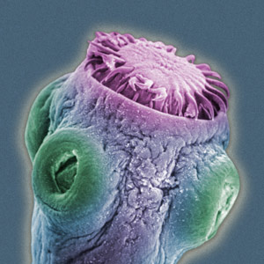
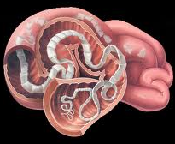
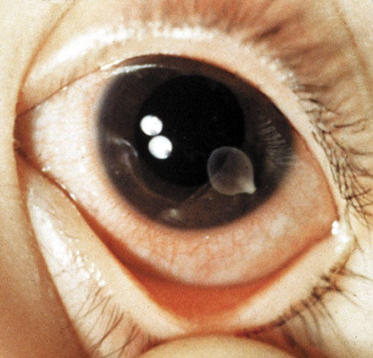
Organization
Class _______________
  Parasitic
  Body organized into a _____________ and many _______________
  Ex: Tapeworms

