Slide 1
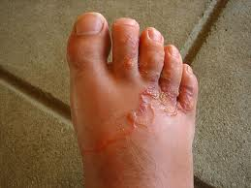
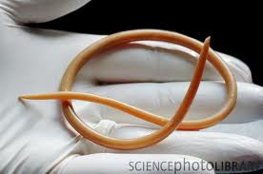
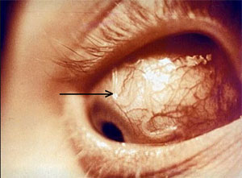
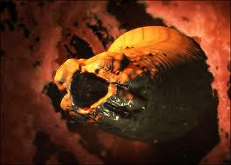
Phylum Nematoda

Slide 2
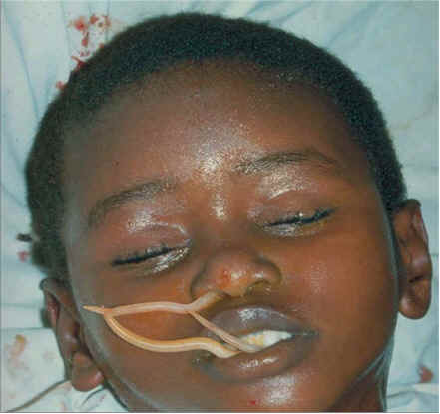
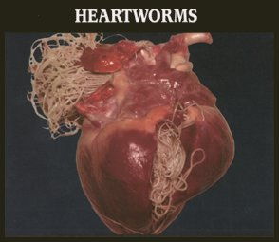
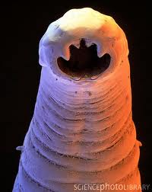
Roundworms
Extremely common cylindrical animals.
90,000 nematodes in a single rotting apple.
Mostly aquatic and damp environments
Mostly free-living
Some parasitic
Ex: Ascaris, hookworm, etc.

Slide 3
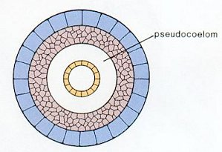
Evolutionary Advances
Pseudocoelomate
Internal fluid-filled body cavity located between the endoderm and mesoderm
Complete Digestive System
3 cell layers
Mesoderm, endoderm and ectoderm
Covered by a protective cuticle
Bilateral symmetry

Slide 4
Systems
Feeding
One way digestive system
Mouth → Pharynx → Intestine → Anus

Slide 5
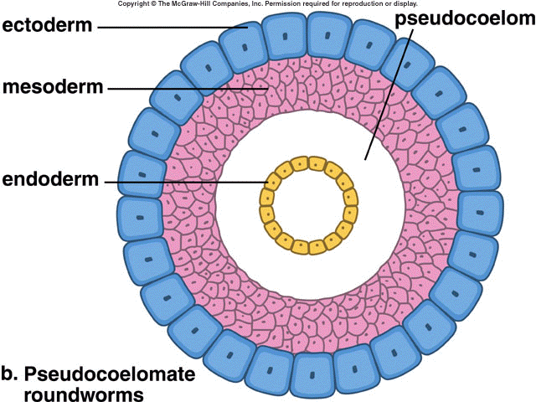
Systems
Respiration
By diffusion
Internal Transport
By diffusion through the pseudocoelom

Slide 6
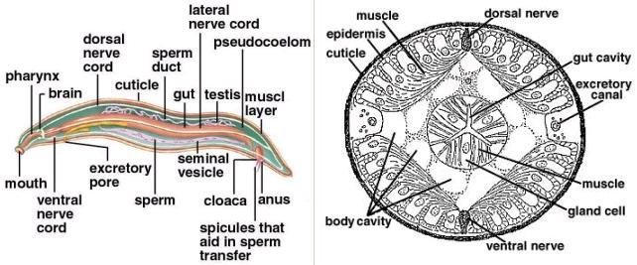
Systems
Excretion
By diffusion into excretory canal.
Exits via excretory pore

Slide 7
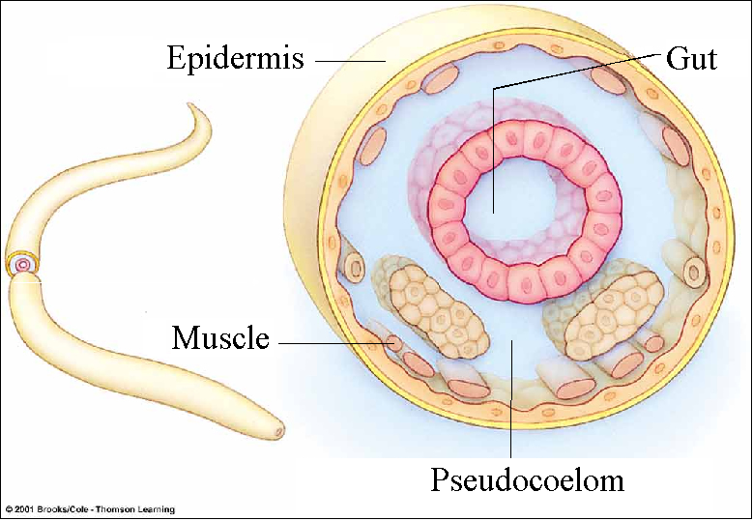
Systems
Movement
Hydrostatic skeleton
Longitudinal muscles only
allow for thrashing motion

Slide 8
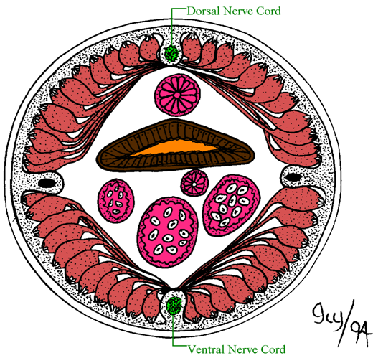
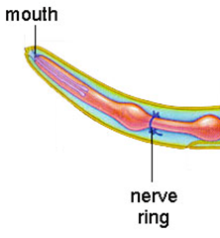
Systems
Response
Ring of ganglia around the pharynx
Dorsal and ventral nerve cords

Slide 9
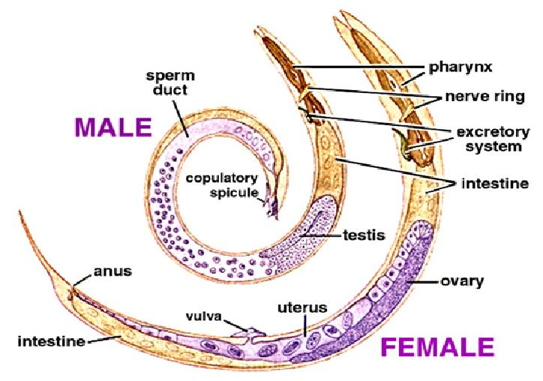
Systems
Reproduction
Sexual reproduction only
Separate sexes
Females
Ovaries
2 uteruses for egg storage join to form a single vagina
Males
Testes produce sperm which exit via sperm ducts
Internal fertilization

Slide 10
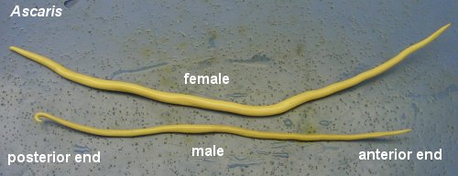
Ecology
Most are inoffensive, eating small organisms; some aerate the soil with their burrows.
Most well-known nematodes are parasitic
responsible for a variety of diseases and disorders
Ex: Ascaris
Common intestinal parasite

Slide 11
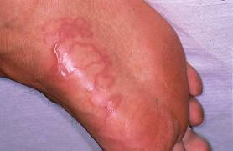
Hookworm
Burrows into body via feet

Slide 12
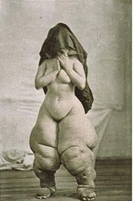
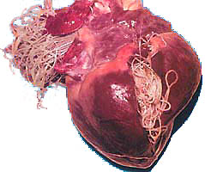
Filaria worm
Blocks lymph vessels
Causes elephantiasis and heartworm

Slide 13
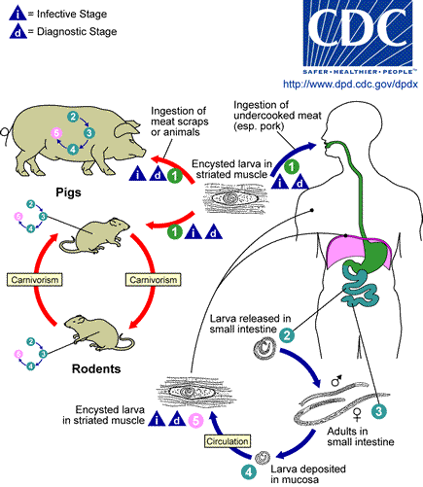
Trichinella
Adults live embedded in walls of host’s intestine, produce larvae that travel through bloodstream to the muscles where they form cysts.

