Slide 1
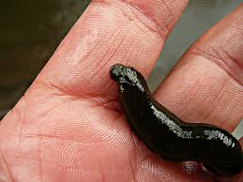
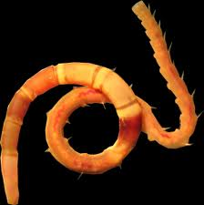
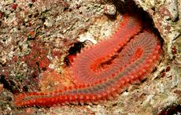
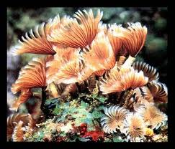
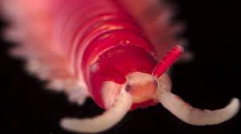
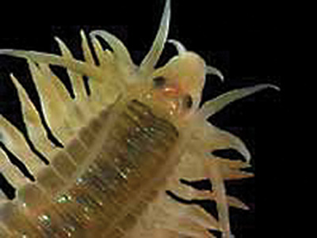
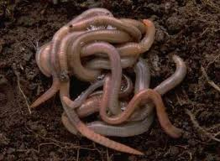
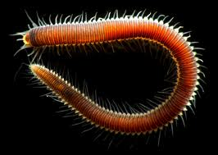
Phylum Annelida

Slide 2
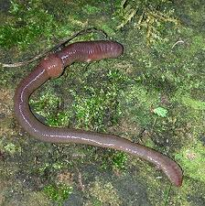
Annelids
Group of soft-bodied animals commonly known as segmented worms.
Ex: earthworm, leeches, etc.
Segments separated internally by septa
Mostly aquatic and damp environments
Many are nocturnal
Mostly free-living heterotrophs

Slide 3
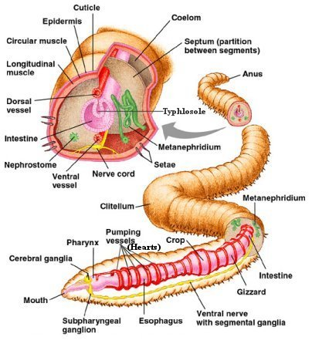
Evolutionary Advances
Segmented Body
Advanced systems
True Coelom (Coelomate)
Mesoderm lined body cavity located throughout the body
Called the peritoneum

Slide 4
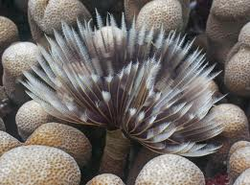
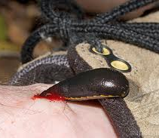
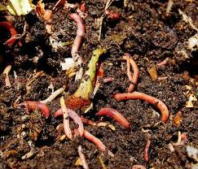
Systems
Tube worm
- filter feeder
Feeding
Most annelids are detritus feeders
a few are filter feeders, carnivores or parasites
Earthworm castings (feces) act as a fertilizer
Leech
- ectoparasite
Earthworms
- Detritus feeders

Slide 5
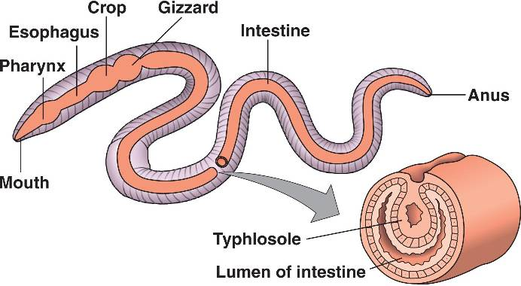
Systems
Feeding
Internal structures of the earthworm include:
Mouth
Pharynx
Esophagus
Crop
Stores food
Gizzard
Grinds food
Intestine
Anus
Food moves through digestive tract by peristalsis

Slide 6
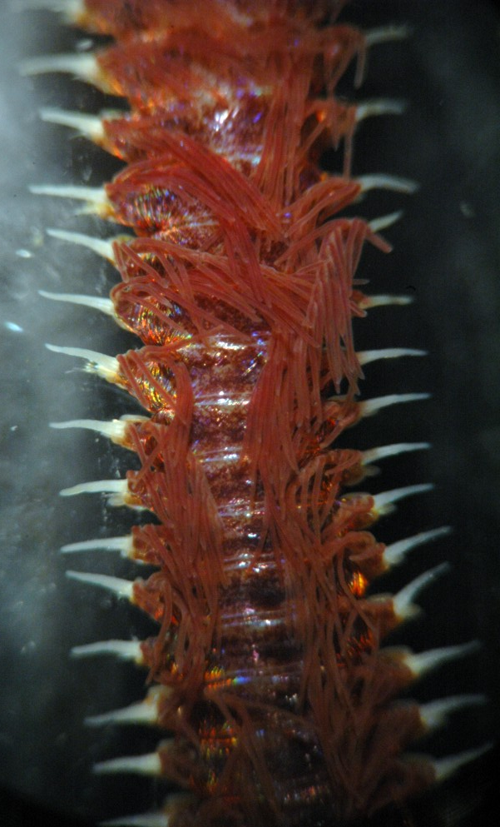
Systems
Respiration
aquatic annelids often breathe through gills
Many annelids can exchange gases through their skin
skin must remain moist to make gas exchange possible
Cuticle holds in moisture

Slide 7
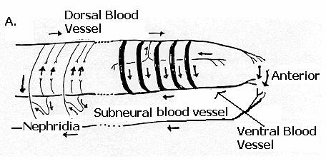
Systems
Circulatory Systerm
5 aortic arches pump blood
closed circulatory systems organized around two blood vessels that run the length of their bodies
(Dorsal and ventral)
Closed means blood is always contained in vessels
blood moves anteriorly in the dorsal vessel
blood moves posteriorly in the ventral vessel
Blood contain hemoglobin – oxygen binding molecule
ring vessels that connect the dorsal and ventral blood supply in each segment
Valves prevent backflow of blood

Slide 8
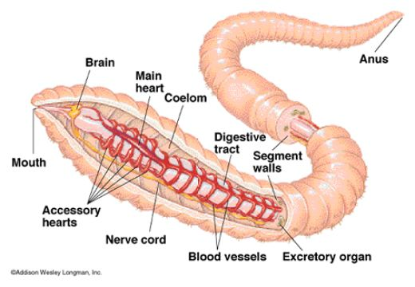

Slide 9
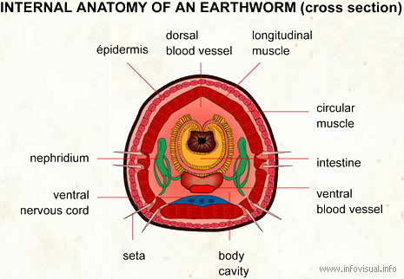
Systems
Excretion
Paired nephridia in each segment remove metabolic waste from the blood and coelom
expel it from the body

Slide 10
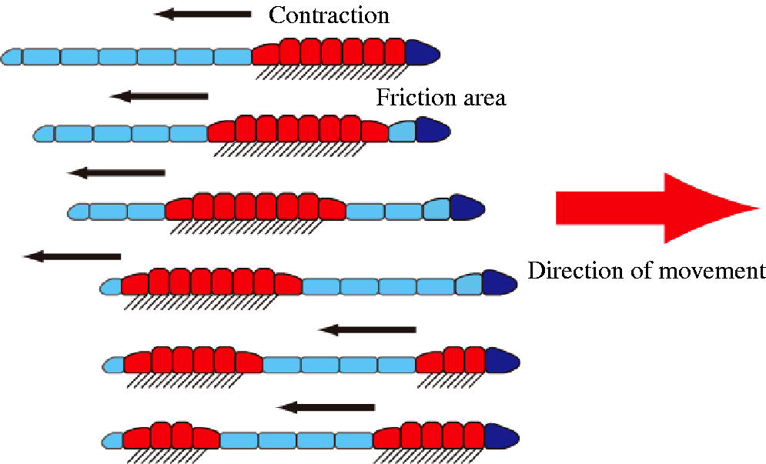
Systems
Movement
Hydrostatic skeleton
Circular and longitudinal muscles
Setae anchor the earthworm during movement

Slide 11
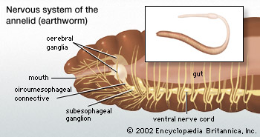
Systems
Nervous system
Most annelids are active animals with well developed nervous systems
Brain sits on top of the gut at the anterior end
Ventral nerve cord
Earthworms have No defined sensory organs
Light sensitive skin

Slide 12
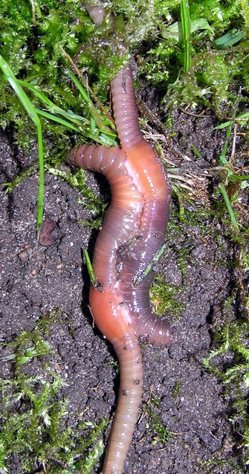
Systems
Reproduction
Most reproduce sexually
Some are able to reproduce asexually by budding
Most are hermaphroditic
some species have separate sexes and external fertilization
Sexual reproduction is by cross-fertilization

Slide 13
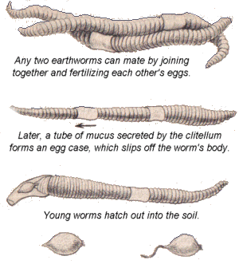
Systems
Earthworm Reproduction
When two earthworms do mate they release sperm to one another.
Each earthworm’s seminal receptacle receives sperm from its mate’s seminal vesicles.
Sperm and eggs are released in cocoons by each individual.

Slide 14
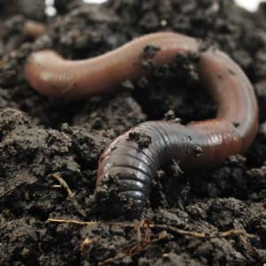
Ecology
Earthworms condition soil by burrowing
helps aerate soil
Improves drainage
Speed the return of nitrogen and other important nutrients from dead organisms
Mixes soil

Slide 15
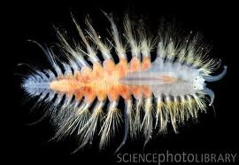
Organization
3 Classes
Class Polychaeta
Marine worms
Parapodia
Paired appendages on each segment
Trochophore larvae
Class Hirudinea
Leeches
Mostly freshwater
Free-living or ectoparasites

Slide 16
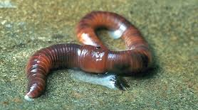
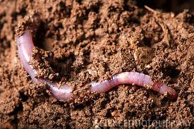
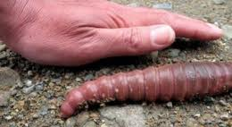
Organization
Class Oligochaeta
Ex. earthworms, etc.
Freshwater or terrestrial
Each segment contains 4 sets of bristles called setae
Light sensitive epidermis
Body adapted for burrowing
Reduced head
Streamlined body

