Slide 1
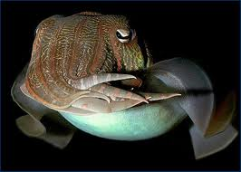
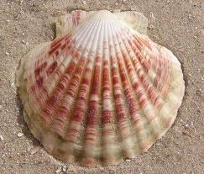
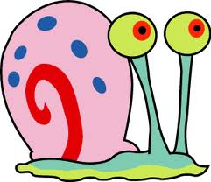
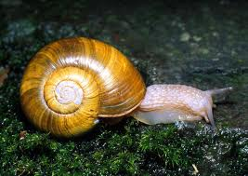
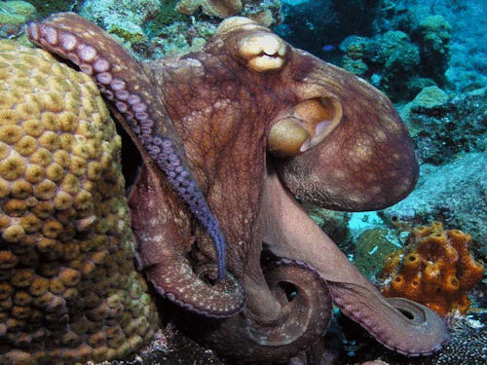
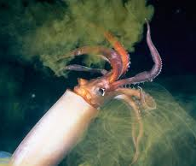
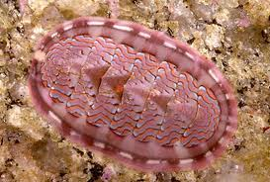
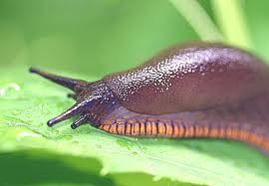
Phylum Mollusca

Slide 2
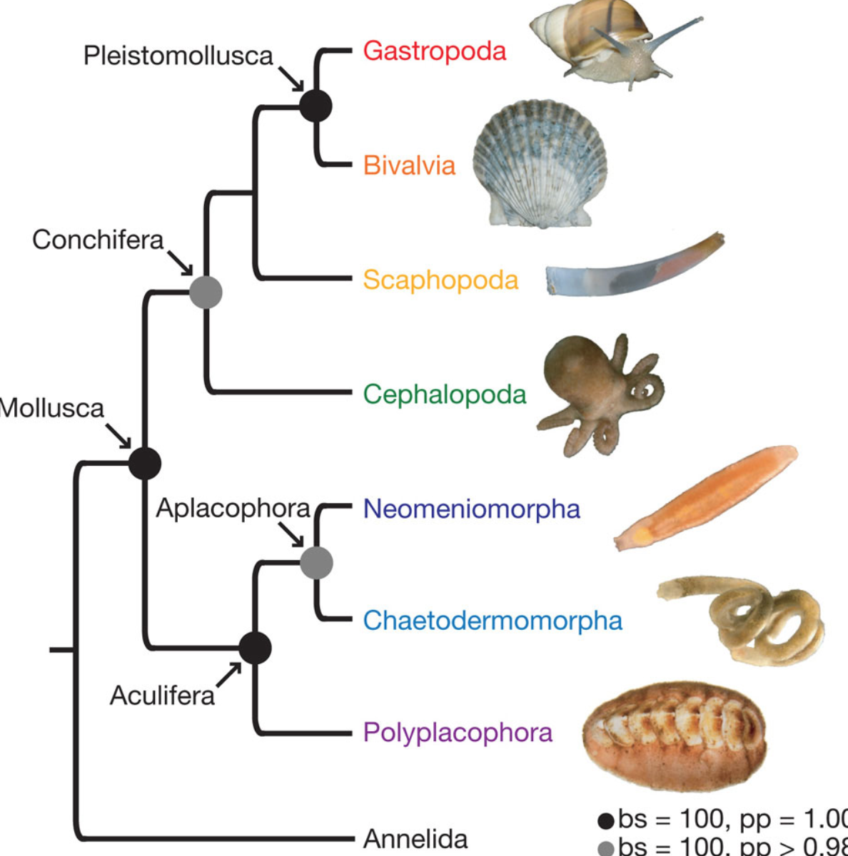
Mollusks
Diverse group of soft-bodied animals sharing a similar body plan. (~100,000 species)
Ex: snails, clams, squid, etc.
Mostly aquatic and damp environments
Free-living heterotrophs
Coelomates

Slide 3
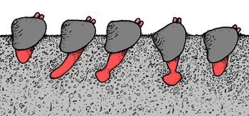
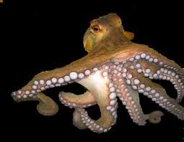
Body Plan
Body plan consists of four basic parts:
Foot
the soft muscular foot usually contains the mouth and other structures associated with feeding
can take many different shapes
flat for crawling;
spade-shaped for burrowing;
tentacles for capturing prey

Slide 4
Body Plan
Mantle
a thin, delicate tissue layer that covers most of a mollusk’s body like a cloak
Shell
found in almost all mollusks; made by glands in the mantle that secrete calcium carbonate (CaCO₃)
Visceral mass
located just below the mantle in most mollusks- this area contains the internal organs

Slide 5
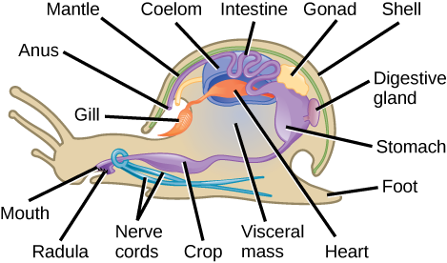

Slide 6
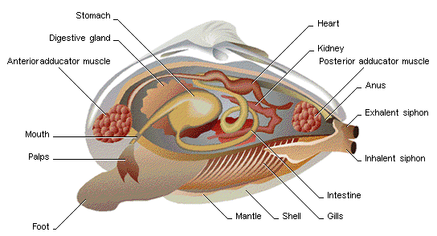

Slide 7
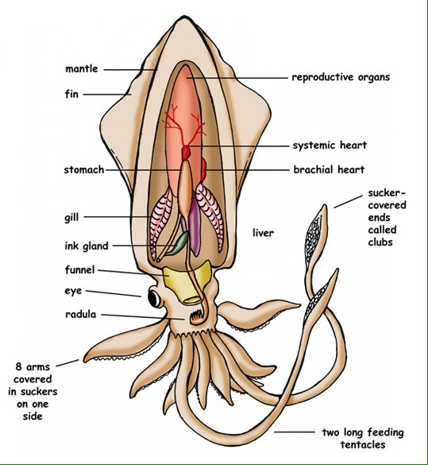

Slide 8
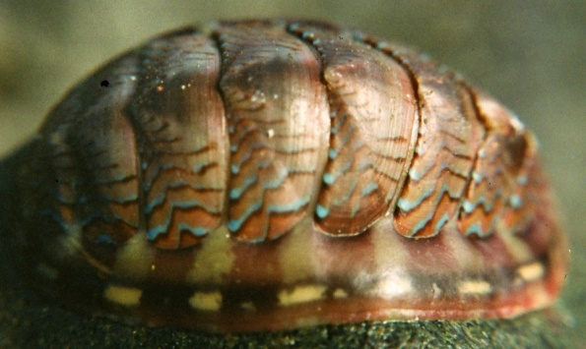
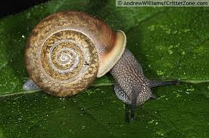
Organization
4 small Classes
Class Polyplacophora
(many plates)
(chitons)
Like a slug with Shell made up of 8 plates
Aquatic
Class Gastropoda
(stomach – foot)
Ex: slugs, snails, etc.
Aquatic or terrestrial

Slide 9
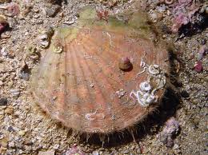
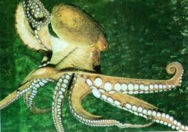
Organization
Class Bivalvia (2 valves)
Ex. Clams, Oysters, etc.
Aquatic, filter feeders
2 shells
Class Cephalopoda
(head - foot)
Ex. Squid, octopus, etc.
Aquatic predators
Foot is tentacled, no shells

Slide 10
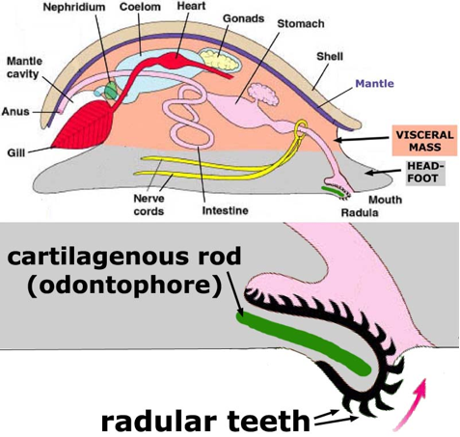
Systems
Feeding
Most mollusks are herbivores, carnivores, or filter feeders
a few are detritus feeders and others are parasites
Class Gastropoda and Polyplacophora
use a radula to scrape algae off rocks in the water, or to eat the buds, roots, and flowers of plants. Carnivores use it to drill holes in pray shell

Slide 11
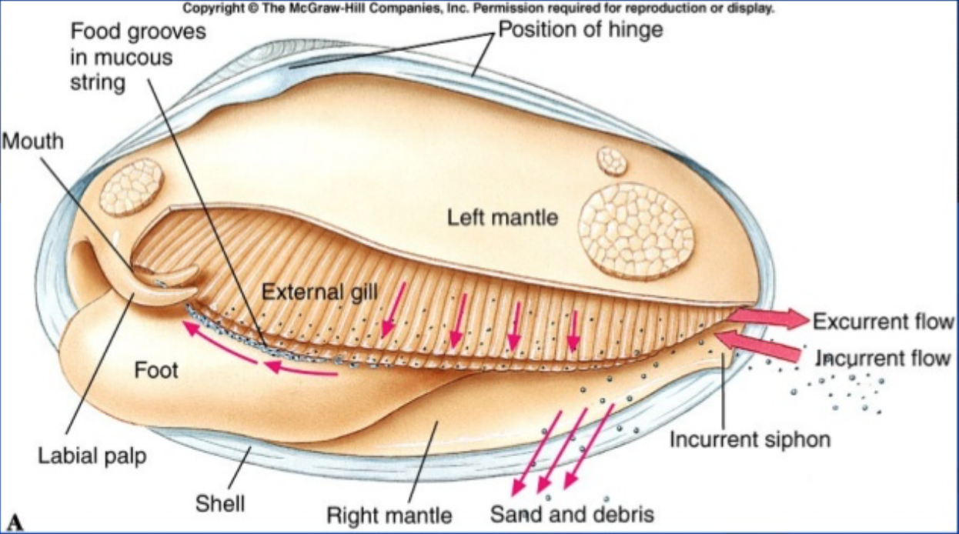
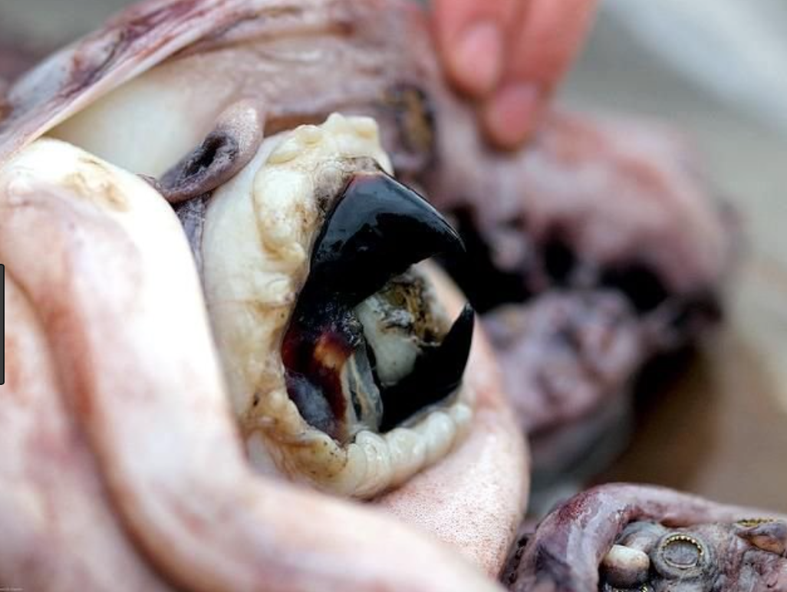
Systems
Class Bivavia
Use a filter feeding mechanism
Pull water in filter using gills and palps, and push water out
Class Cephalopoda
Use arms and tentacles with suction cups to grab pray
Use a hard, sharp beak to tear into pray.

Slide 12
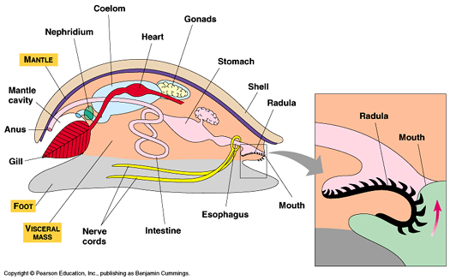
Systems
Feeding
Internal structures are similar
Mouth → Esophagus → Stomach → Intestine → Anus
Digestive gland provides enzymes for digestion

Slide 13
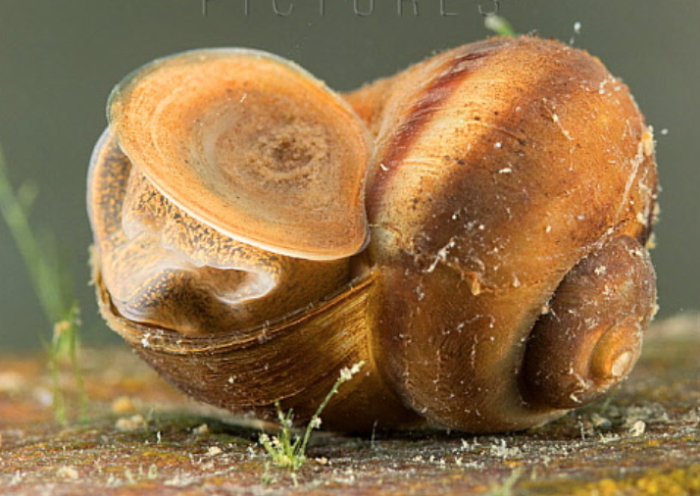
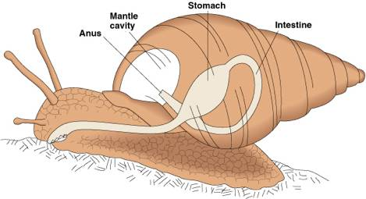
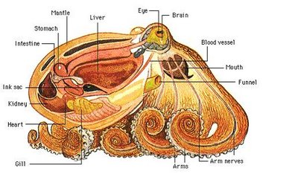
Systems
Respiration
aquatic mollusks use the gills for gas exchange
land mollusks use a mantle cavity for gas exchange
Mantle cavity must be kept moist for gas exchange
Operculum can seal off shell to prevent desiccation.

Slide 14
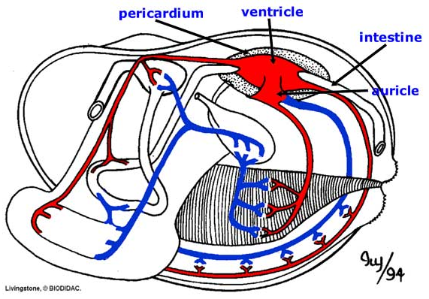
Systems
Circulation
blood pumped into an open circulatory system (except cephalopods)
blood flows into sinuses where it “bathes” the organs and exchange occurs
blood oxygen carried by hemocyanin
cephalopods have a closed system
required for fast moving animals

Slide 15
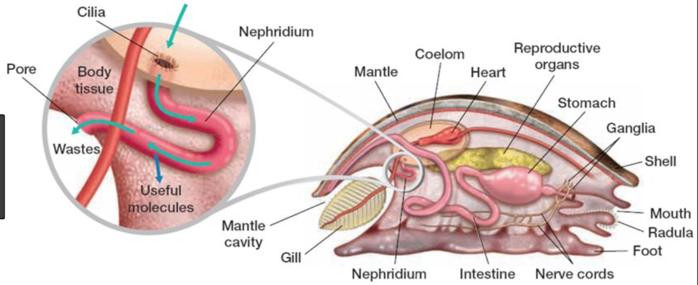
Systems
Excretion
nephridia remove metabolic waste from the blood and expel it from the body

Slide 16
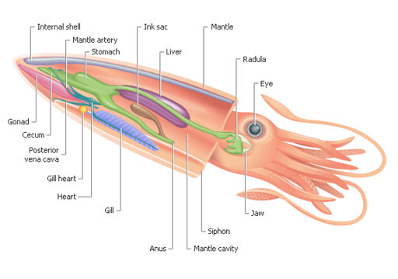
Systems
Movement
shell consisting of
Structured outer layer
middle layer
pearly inner layer
Strong muscles
Hydrostatic skeleton
Slow movement using foot
EXCEPT for Cephalopods
use siphon for jet propulsion

Slide 17
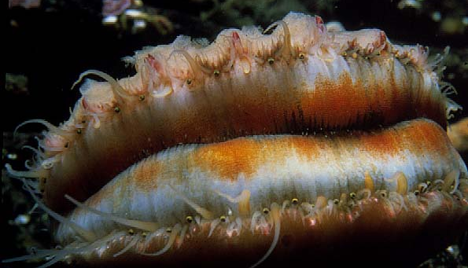
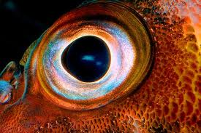
Systems
Response(nervous system)
Bivalves have a reduced nervous system
No Brain
simple touch receptors, statocysts and ocelli
Gastropods have a simple brain and sense organs
Cephalopods have an advanced brain and sense organs
well developed brain and eyes
ability to learn and remember for long periods of time

Slide 18
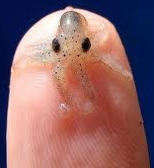
Systems
Reproduction
separate sexes
External fertilization forming larva
cephalopods and some gastropods have internal fertilization
some species able to switch sexes
Cephalopods do not exhibit a larval stage

Slide 19
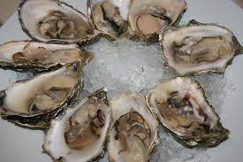
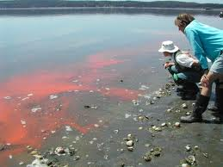
Ecology
food source for humans and other animals
oysters produce pearls from nacre secreted by mantle
bivalves are ecological monitors
Bioaccumulate toxins
some gastropods cause damage to crops
medical and biochemical uses
ex. mussels produce a natural super-glue
Snails never develop cancer

