Slide 1
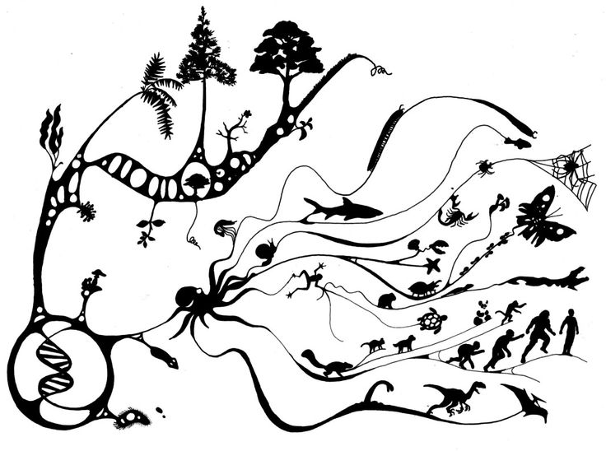
Agents of Evolution

Slide 2
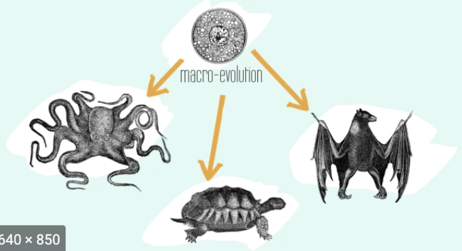
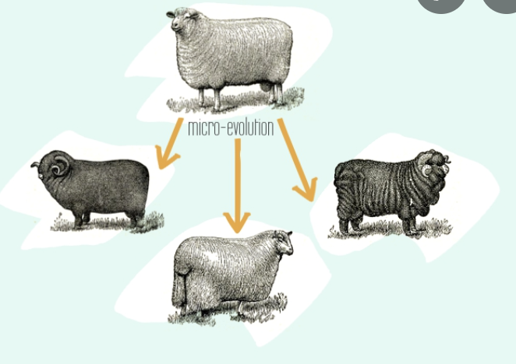
Macroevolution Microevolution
Evolution of one ancestral species to new distinct species
Happens over a long period of time (evidence relies on fossils)
Relies on Microevolution
Changes in the gene pool of one species that gives rise to variation in one species
Happens over a relatively short time
Over extended time, gives rise to Macroevolution and speciation

Slide 3
Agents of Evolution
The mechanisms of change vary.
Evolution by Natural Selection as proposed by Darwin/Wallace is just ONE explanation of HOW species change.
Agents of Evolution refers to these various mechanisms
Natural Selection (we have learned before)
Mutation
Gene Flow
Genetic Drift
Non-Random Mating
Other Vocabulary: Founder’s Effect, Bottleneck Effect

Slide 4
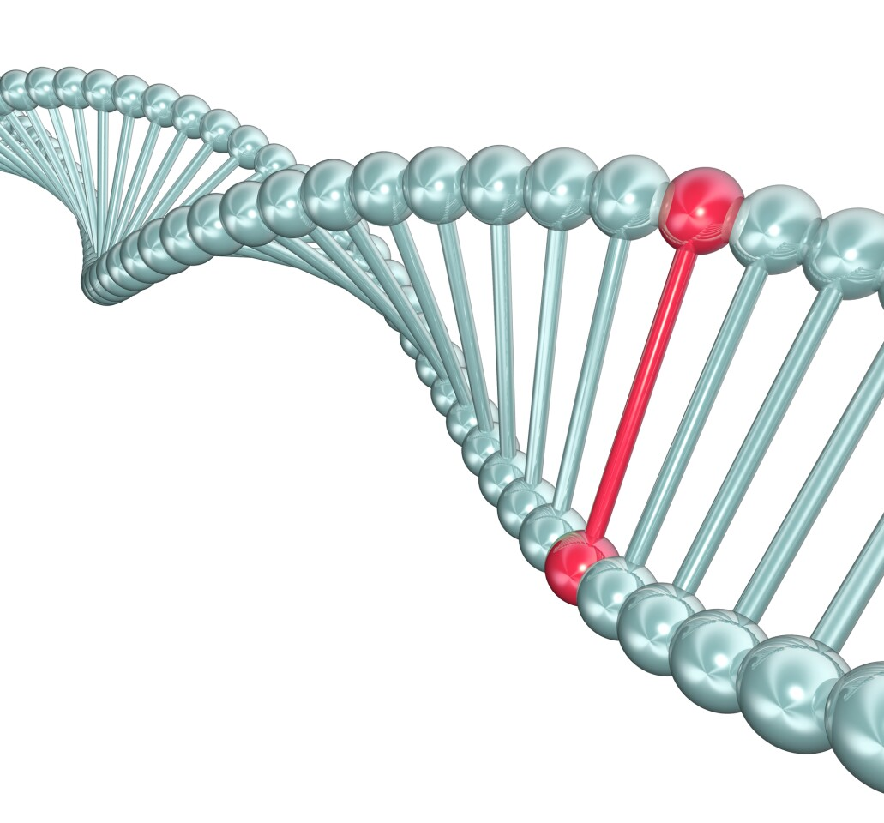
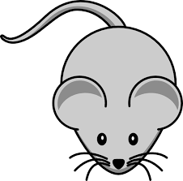
2. Mutation
A change in the DNA of an organism that may result in a phenotypic change that can be beneficial, neutral or detrimental.
what determines which variant increases and which decreases?
mutation
new variant

Slide 5
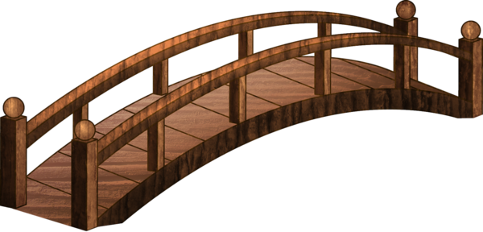
3. Gene Flow
The movement of alleles (variants) from one population to another through the movement of individuals that carry that allele
what determines which variant increases and which decreases in each side?

Slide 6
4. Genetic Drift
Individuals may die or not have offspring due to random reasons
If a certain allele (variant) decreases in frequency or is eliminated due to random reasons, the population will change.
Happens more often in smaller, isolated populations

Slide 7
4. Genetic Drift – Continued (Small population)
Black allele/variant is eliminated due to random reasons

Slide 8
4. Genetic Drift – Continued (large population)
Black allele/variant is not eliminated, but just reduced, because population is larger and the randomness doesn’t affect it as much

Slide 9
5. Non-Random Mating
Individuals looks for specific traits in their mating partner, which means
Not everyone gets to pass on their alleles
Some individuals pass on their alleles more than others

Slide 10
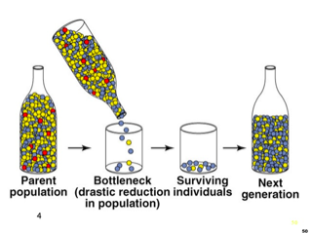
Bottleneck & Founders Effects
Population bottlenecks occur when a population’s size is reduced for at least one generation losing variation of alleles
Founders Effect occurs when a new colony is started by only a few members of the original population limiting the alleles to the few individuals that started the colony

