Slide 1
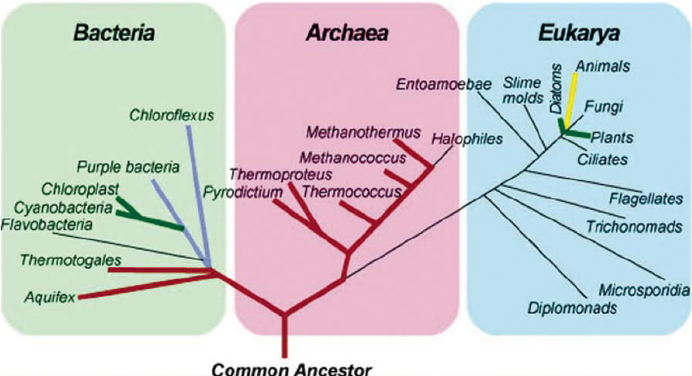
Bacteria
Classification

Slide 2
Bacteria
Classification
All _________used to be Kingdom ________
But now they are 2 separate Domains
- Domain _________________________
Oldest living organism on earth – live in _________________environments
- Domain _________________________
everyday bacteria – live ____________

Slide 3
General Structure (both domains)

Slide 4
General Structure (both domains)
______________ – Dictates cell ____________
____________ – circular DNA used specifically for sex
_________________ – Make proteins
Cell membrane/cell wall – give _______________ to the bacterial cell
_____________– thick gelatin around the cell wall, which hardens when exposed to ______________ (heat/drought) – protects the bacteria
___________________– whip like structures used for _____________________________

Slide 5
Archaea vs. Bacteria vs. Eukarya

Slide 6
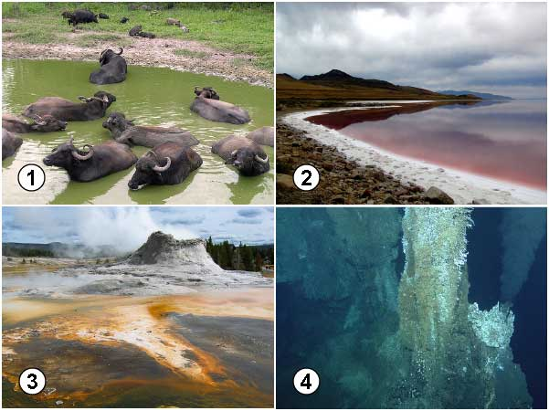
Domain Archaea(archaeabacteria)

Slide 7
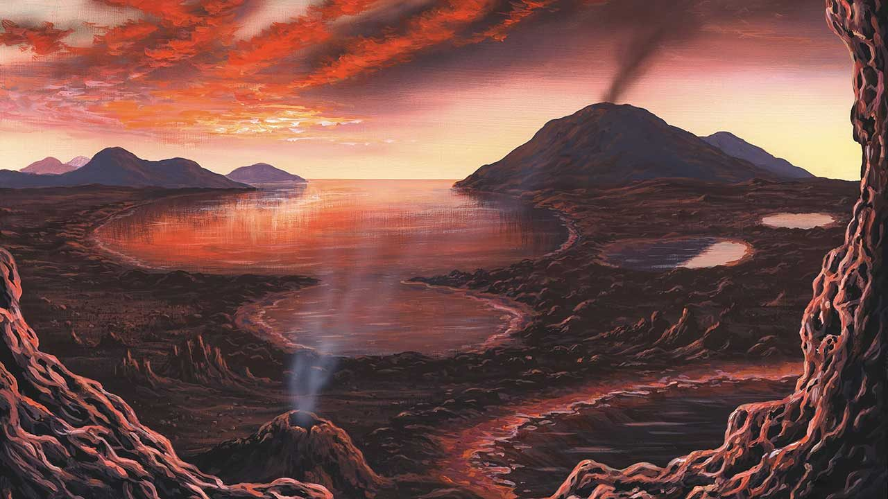
Domain Archaea
Ancient organisms, first to live on earth
Live in ___________, ______, ________,_____ environments (hydrothermal vents, swamps, salt lakes, volcanic environments.

Slide 8
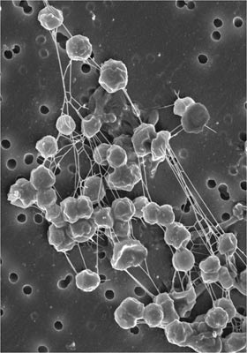
Domain Archaea
______________ - These Archebacteria are anaerobes. They make methane (natural gas) as a waste product. They are found in swamp sediments, sewage, and in buried landfills, guts of large mammals, other….
In the future, they could be used to produce methane as a byproduct of sewage treatment or landfill operation.

Slide 10
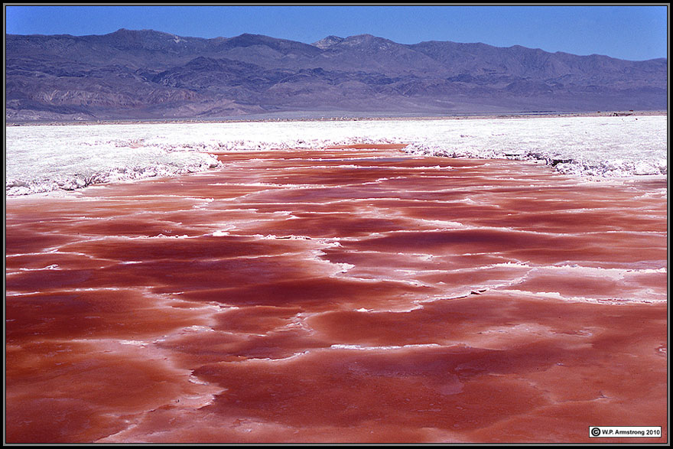
Domain Archaea
2. _________ - These are salt-loving Archaea that grow in places like the Great Salt Lake of Utah or salt ponds on the edge of San Francisco Bay. Large numbers of certain halophiles can turn these waters a dark pink. These archaea are aerobic.

Slide 11
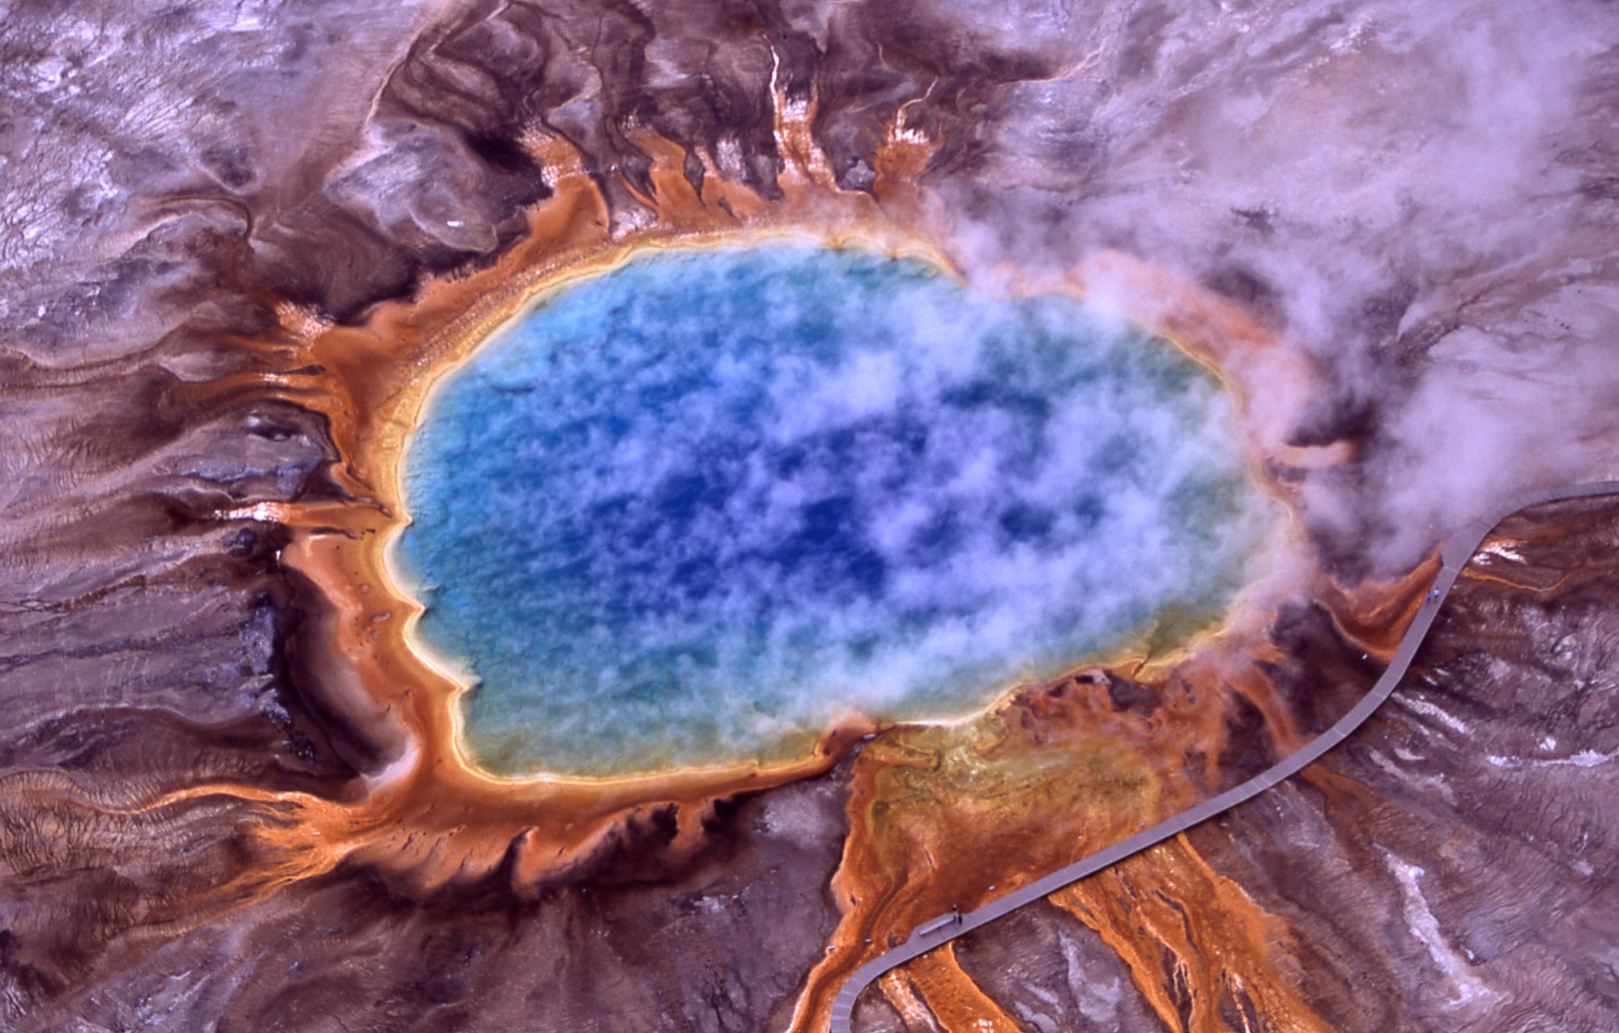
Domain Archaea
3. ________________ - These are Archaebacteria from hot springs and other high temperature environments.
Some can grow above the boiling temperature of water. They are anaerobes, performing anaerobic respiration.

Slide 12
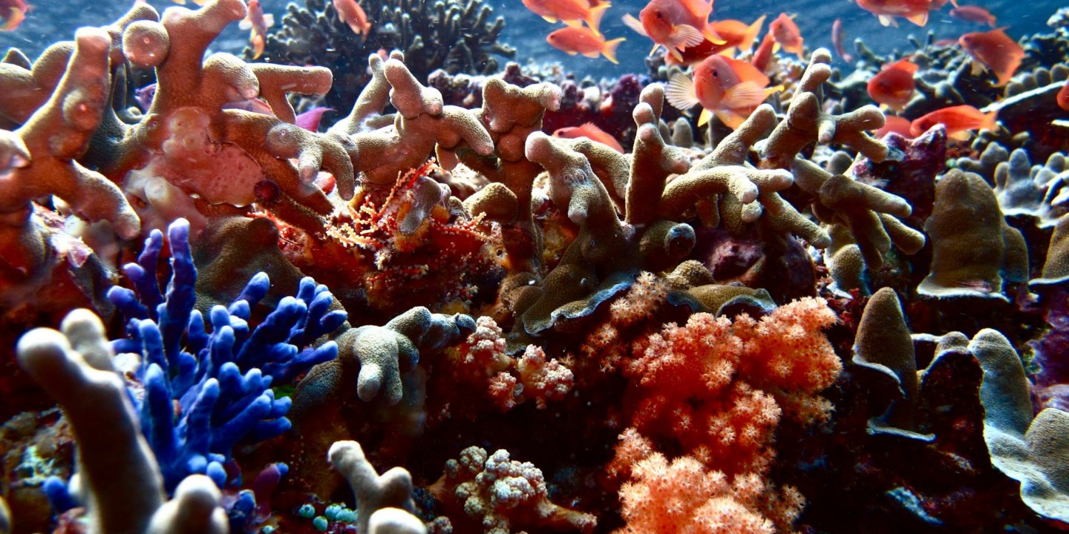
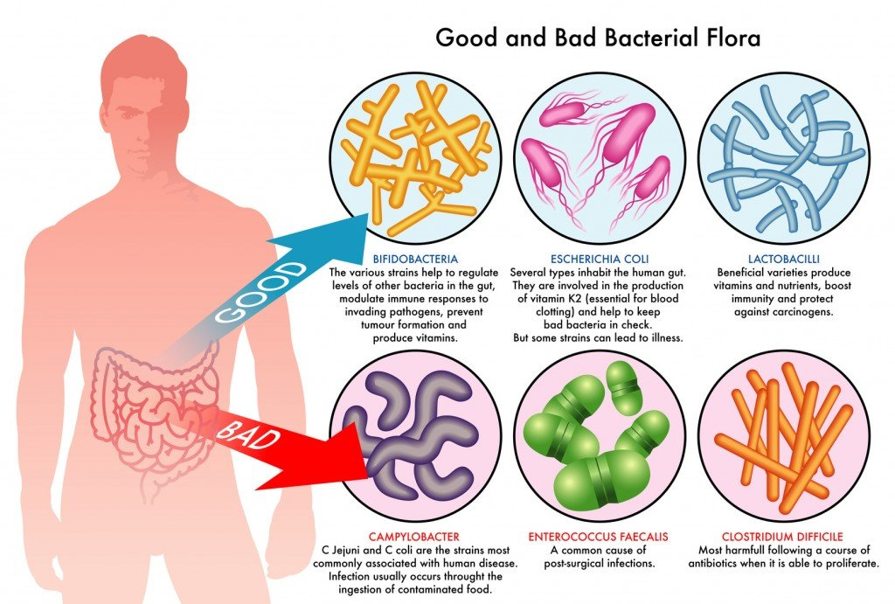
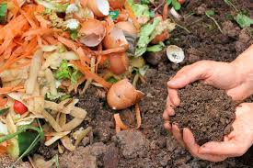
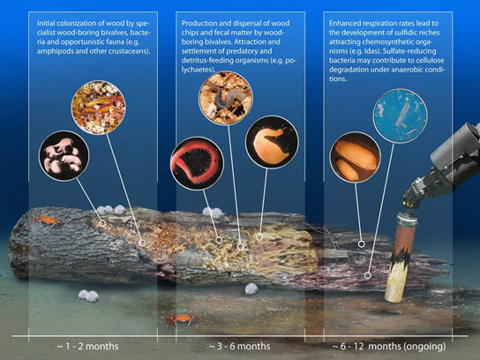
Domain Bacteria (Eubacteria)
Found EVERYWHERE else.
Fun fact: Each square centimeter of your skin averages about 100,000 bacteria. A single teaspoon of topsoil contains more than a billion (1,000,000,000) bacteria.

Slide 13
Bacteria Shapes and Colony types

Slide 14
Bacteria – Shapes and Colony types
Shapes
Colonies
Diplococcus
Streptococcus
Staphylococcus

Slide 15
Mode of feeding
________________ – Make their own food
Photoautotroph – use light
Chemoautotrophs – use chemicals
________________ – Can’t make their own food, must eat organic matter from other organisms (these are the good and bad bacteria we hear about)

Slide 16
Heterotrophs
________________ – feed on recycled organic material
_______________ – parasitic, disease causing bacteria, feed on live organisms
_________________– Found on roots of plants. Feed on sugars of plant root while providing nitrogen to plant roots

Slide 17
Sex and Reproduction
Sex – the exchange of DNA to form new genetic material
Reproduction – multiplication of an organism.
In many organisms they happen simultaneously but that’s not true in every case.

Slide 18
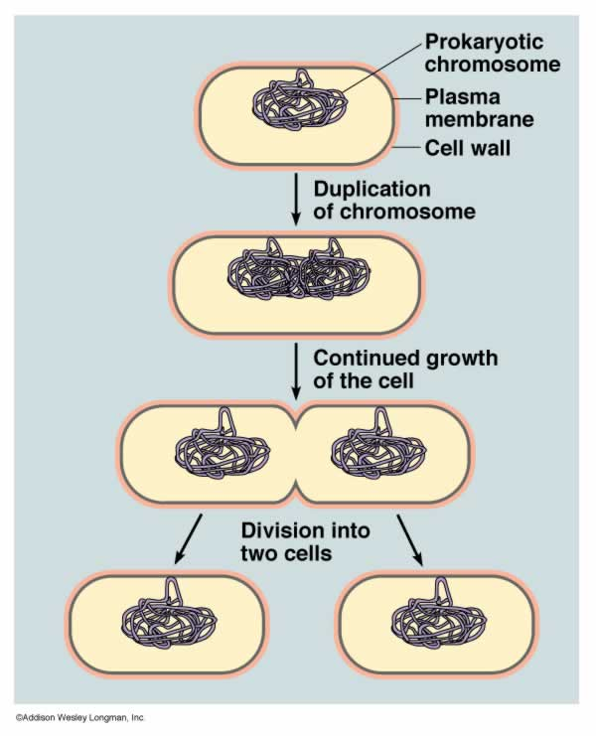
Reproduction in Bacteria
Binary Fission – the splitting of one bacteria into two. (basically mitosis). No new DNA

Slide 19
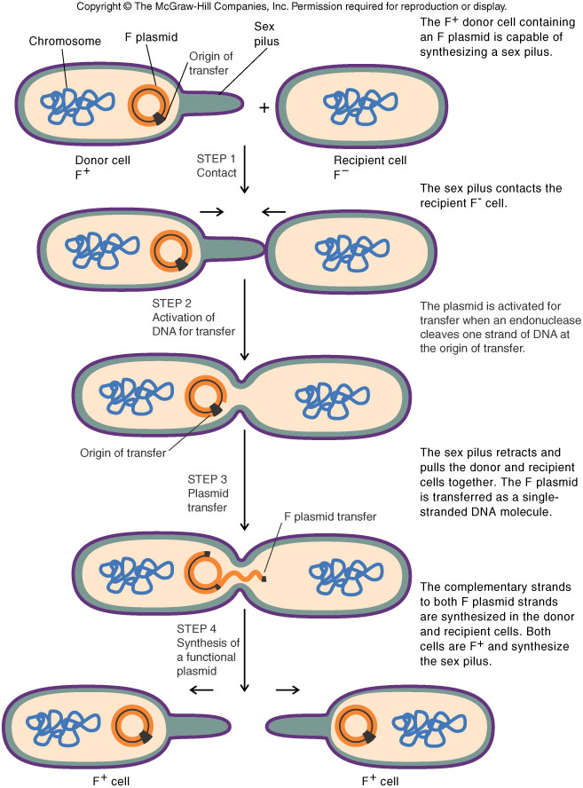
Sex in Bacteria
Conjugation – the transfer of “PLASMID” from one bacteria to another. The plasmid will be incorporated into the the DNA of new bacteria.
It can contain mutations that aid the bacteria in survival

