Slide 1
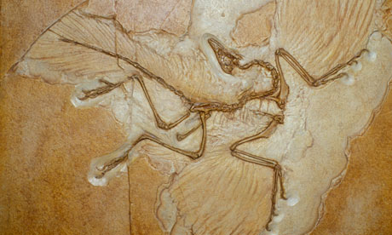
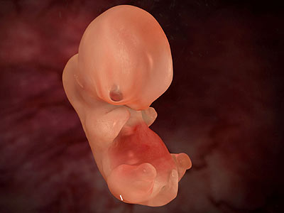
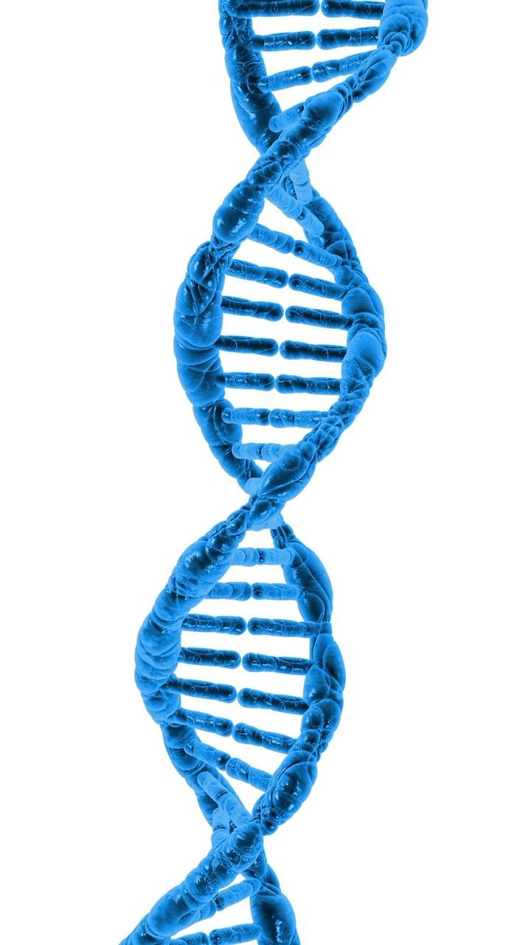
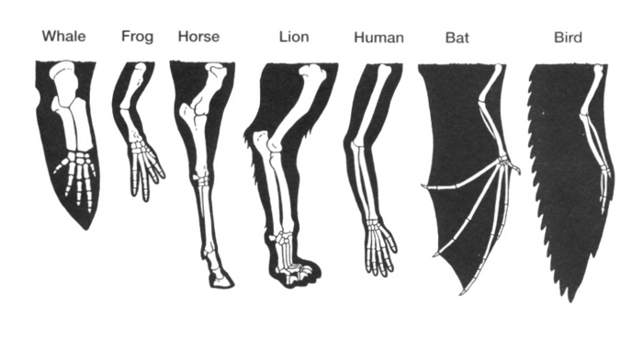
Evidences of Evolution

Slide 2
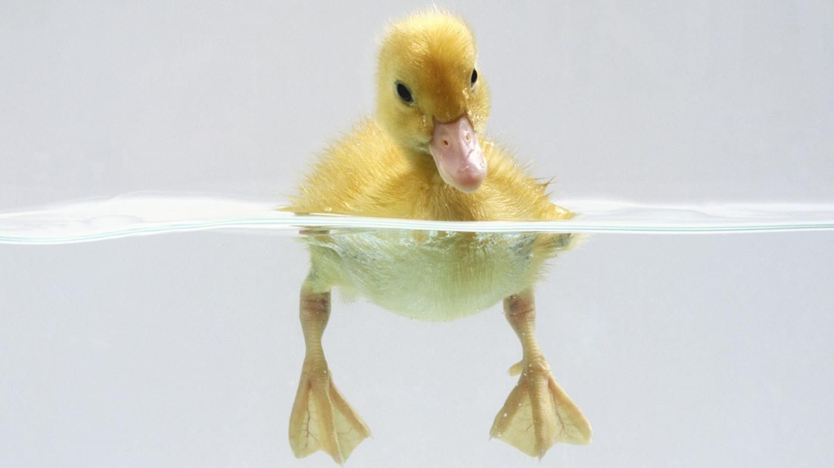
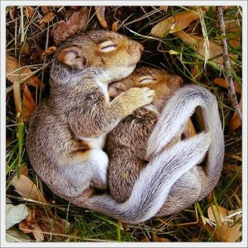
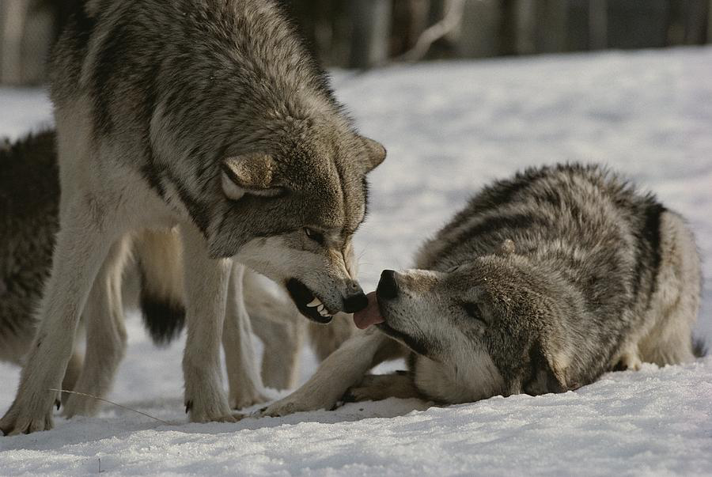
Direct Evidences
Adaptations: any variation that allows an organism to survive and reproduce in a particular environment.
_______________
_______________
_______________

Slide 3
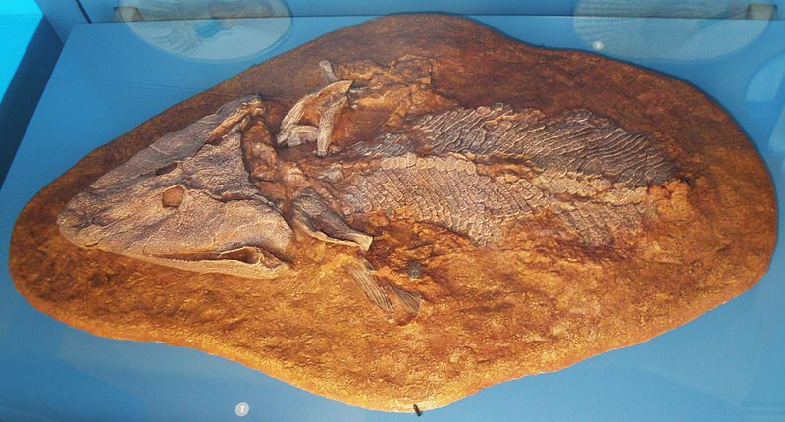
Direct Evidences
2. Fossils: _________ of ancient life preserved in the earth’s crust, often in the form of ________, ________, _________, or ____________.

Slide 4
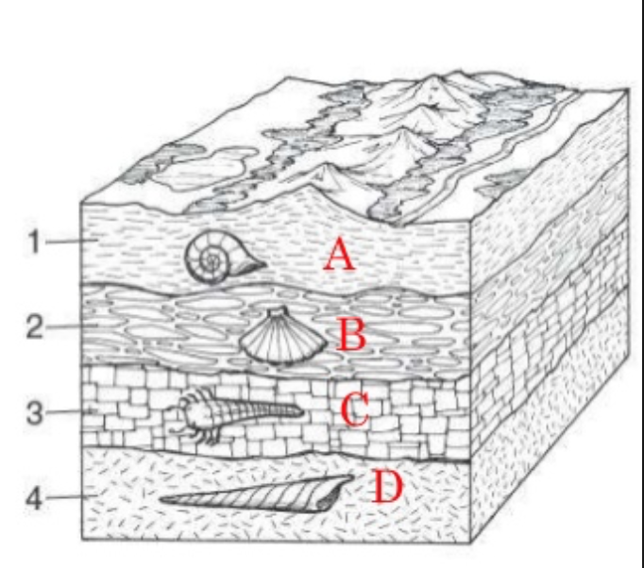
Direct Evidences
Dating Fossils
Relative dating: _______________________
____________________________________
__________. The older fossils
are in older sediments
usually _______ the
younger fossils in the
newer sediment, on
the _______.

Slide 5
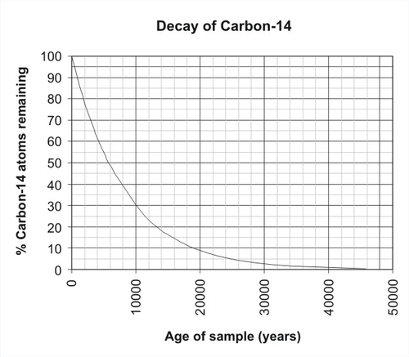
Direct Evidences
Dating Fossils
Radioactive dating: _____________________
_____________________________________
_____________________________________.

Slide 6
Indirect Evidences
____________________
____________________
____________________
____________________
____________________
____________________

Slide 7
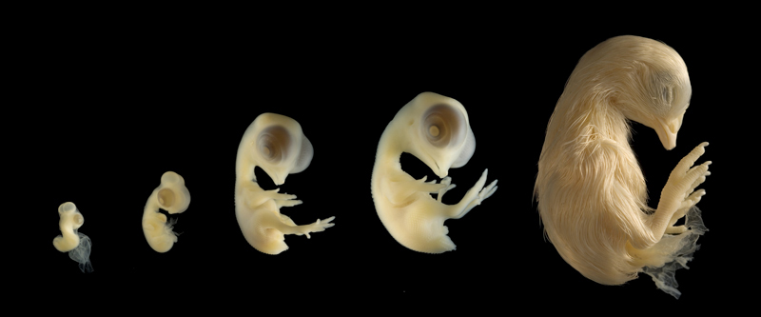
Indirect evidences - Embryology
_______________________________________________________________________________________________________________.

Slide 8
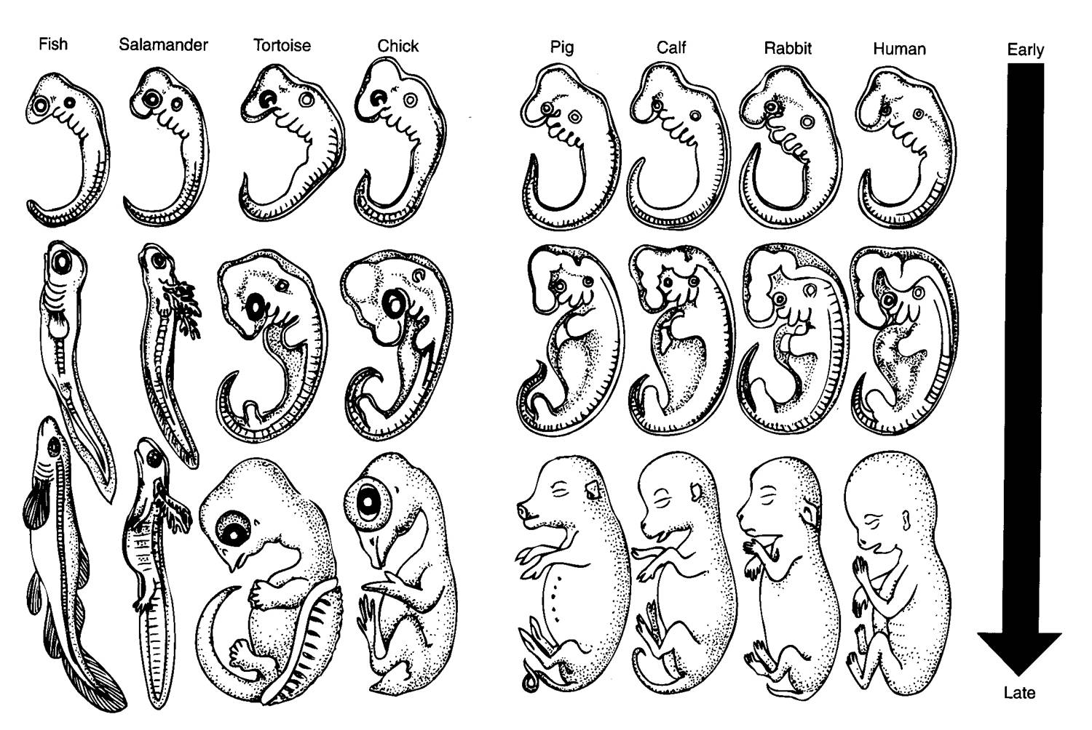
Indirect Evidences - Embryology

Slide 9
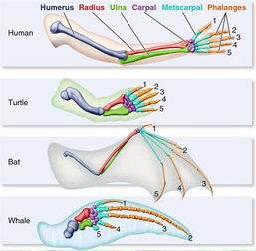
Indirect Evidences Homologous Structures
__________________________________________________________________________.

Slide 10
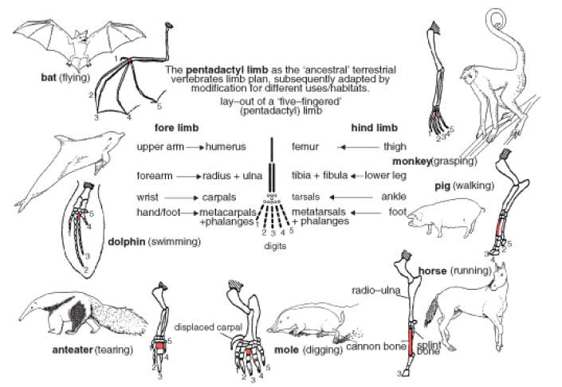
Indirect Evidences Homologous structures
Divergent Evolution: the __________________________
________________ from a common ancestor resulting in ________________ structures.

Slide 11
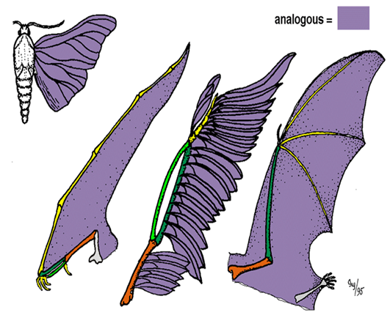
Indirect Evidences Analogous Structures
____________________________________________________________________.

Slide 12
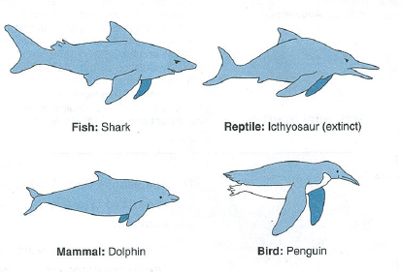
Indirect Evidences Analogous Structures
Convergent evolution: The _______________________ ____________________due to ______ selective pressures, resulting in ______________ structures.

Slide 13
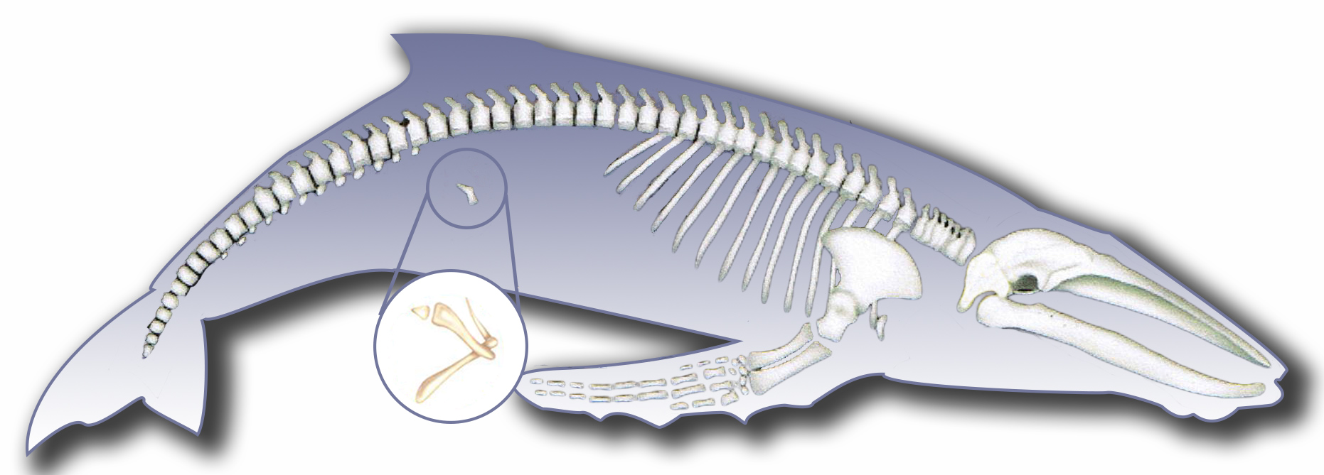
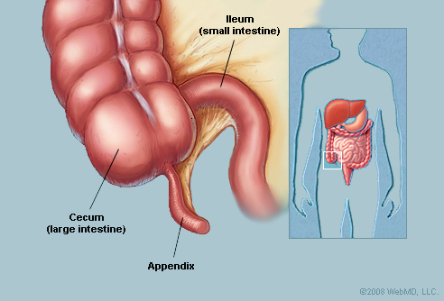
Indirect Evidences Vestigial Structures
__________________________________________________________________________________________________________.

Slide 14
Indirect Evidences - Physiological
The _______________________in the body can be the same or different depending on the evolutionary history of the organisms.
- __________________in cows and injected in humans, does the _____________, making them ______ related to each other than other organisms
Same type of waste is excreted from _____ and _______ making them _____ related to each other than to other organisms

Slide 15
Indirect Evidences – Biochemical
Comparison of the DNA molecules of organisms shows how closely they are related to one another.

Slide 16
Indirect Evidences – Biochemical

