Slide 1
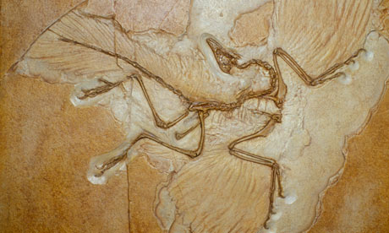
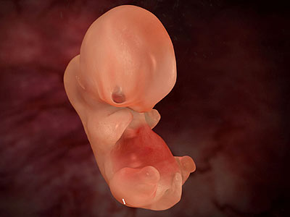
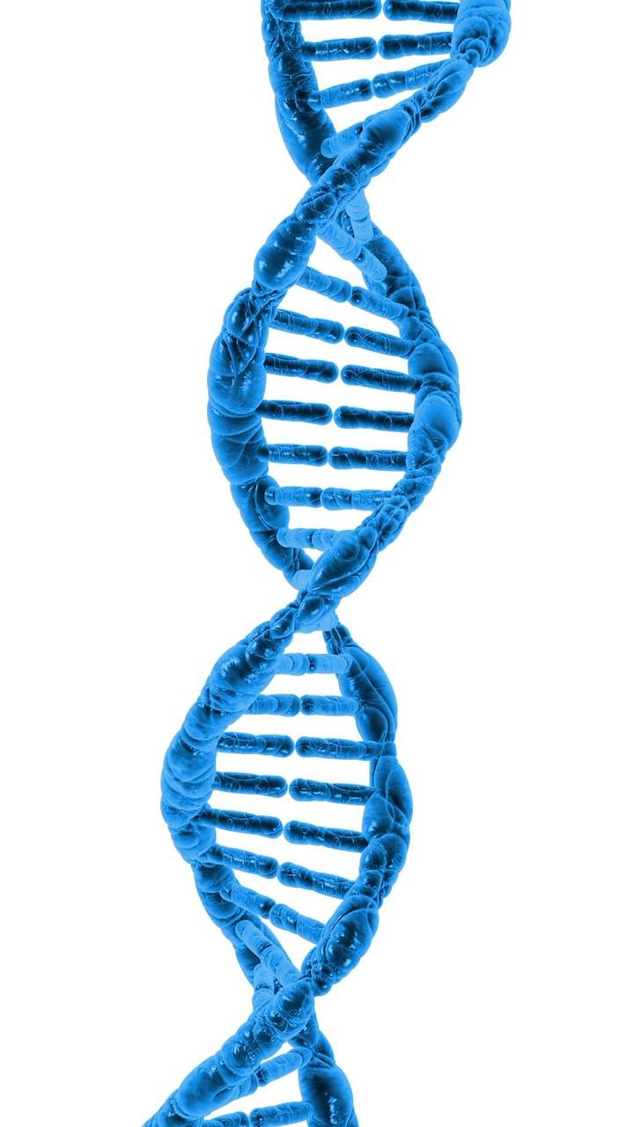
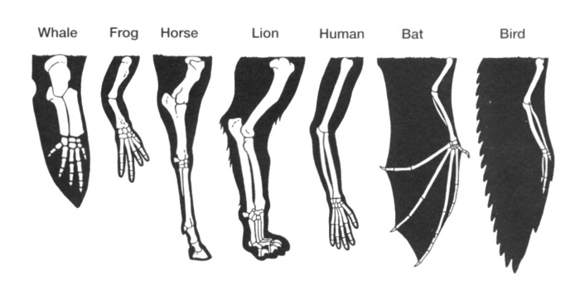
Evidences of Evolution

Slide 2
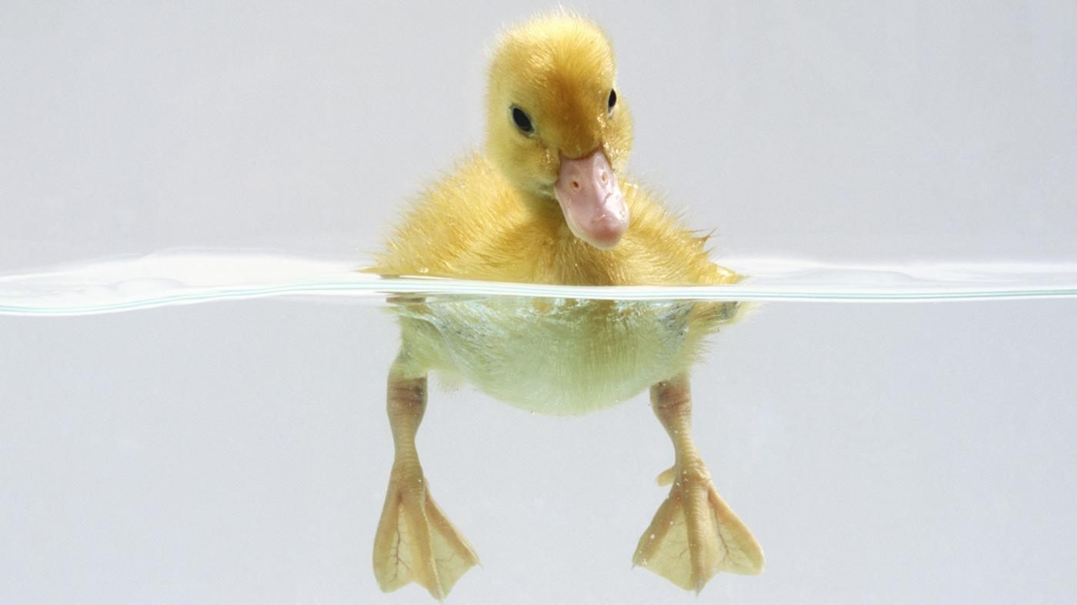
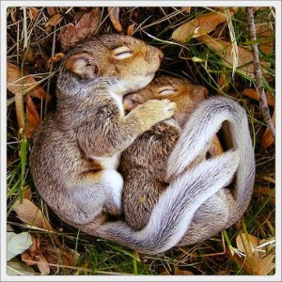
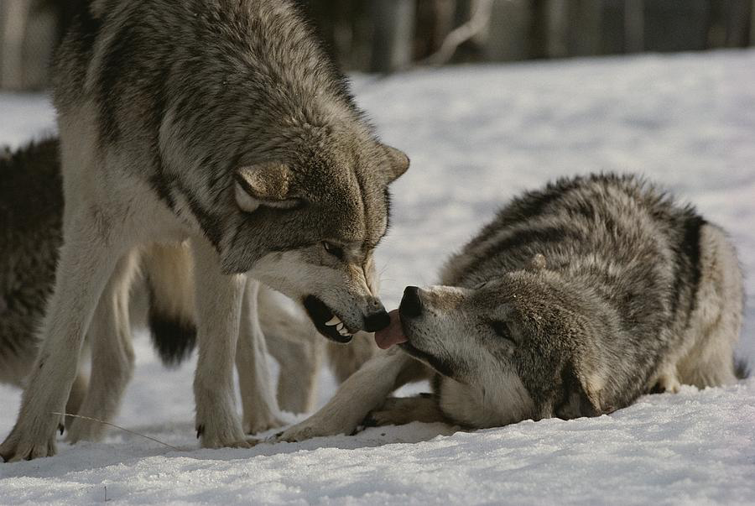
Direct Evidences
Adaptations: any variation that allows an organism to survive and reproduce in a particular environment.
Structural
Physiological
Behavioural

Slide 3
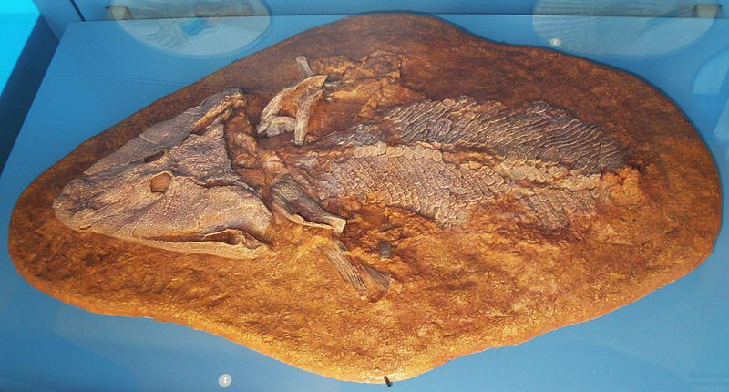
Direct Evidences
2. Fossils: Evidences of ancient life preserved in the earth’s crust, often in the form of shells, bones, imprints, or traces.

Slide 4
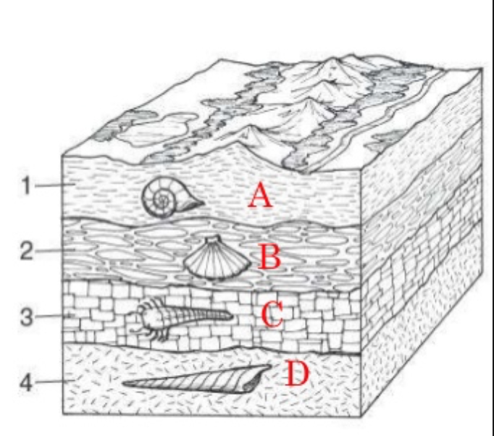
Direct Evidences
Dating Fossils
Relative dating: using layers of sediment to determine the age of fossils as related to one another. The older fossils
are in older sediments
usually under the
younger fossils in the
newer sediment, on
the top.

Slide 5
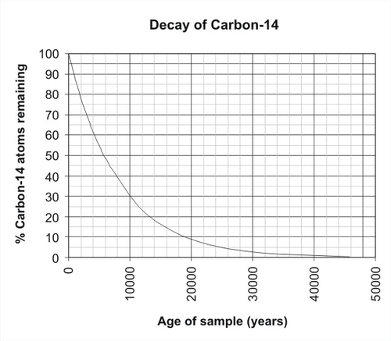
Direct Evidences
Dating Fossils
Radioactive dating: Using the proportions of radioactive isotopes in the fossil sample we can get an absolute date of the fossil.

Slide 6
Indirect Evidences
Embryology
Homologous structures
Analogous structures
Vestigial structures
Physiological evidences
Biochemical evidences

Slide 7
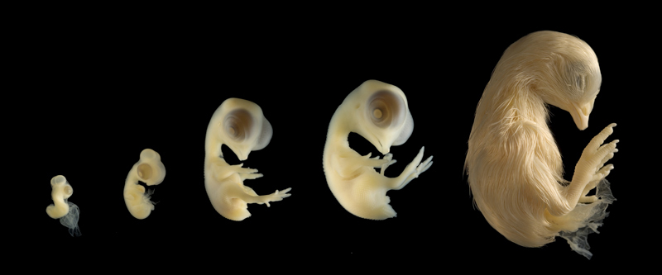
Indirect evidences - Embryology
The study of the development of organisms from the time of fertilization until their first breath.

Slide 8
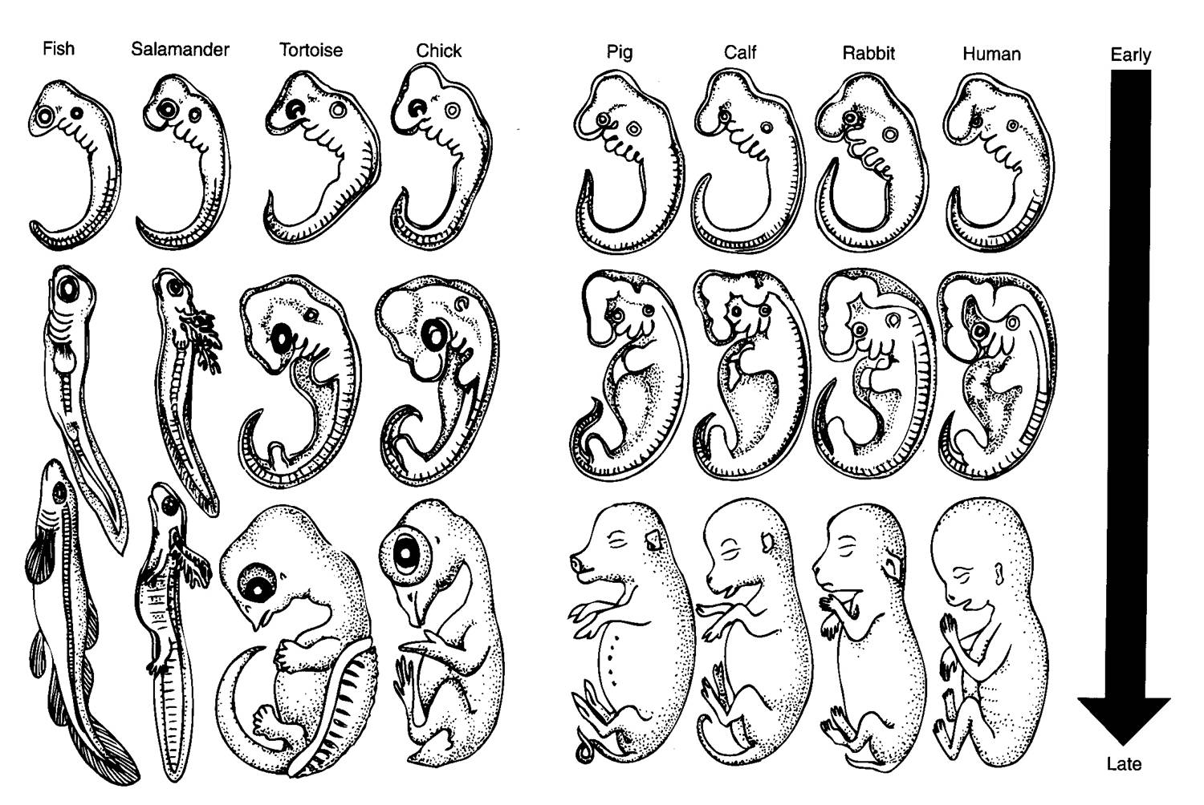
Indirect Evidences - Embryology

Slide 9
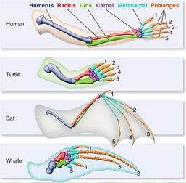
Indirect Evidences Homologous Structures
Structures similar in origin but different uses in different species.

Slide 10
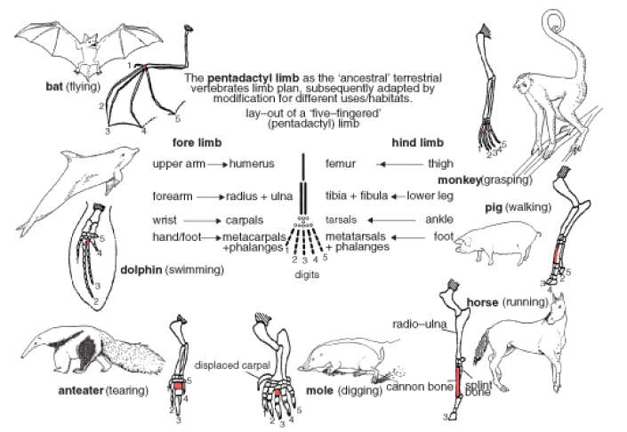
Indirect Evidences Homologous structures
Divergent Evolution: the development of two or more different species from a common ancestor resulting in homologous structures.

Slide 11
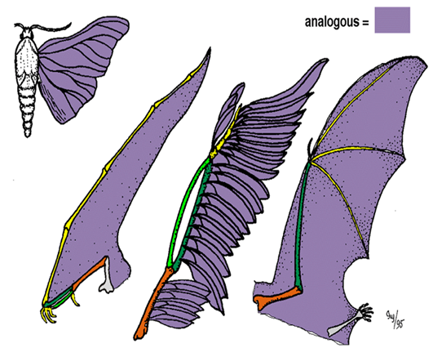
Indirect Evidences Analogous Structures
Structures similar in function and appearance but different in origin.

Slide 12
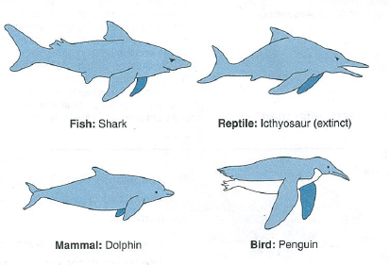
Indirect Evidences Analogous Structures
Convergent evolution: The development of the same functioning structures due to same selective pressures, resulting in analogous structures

Slide 13
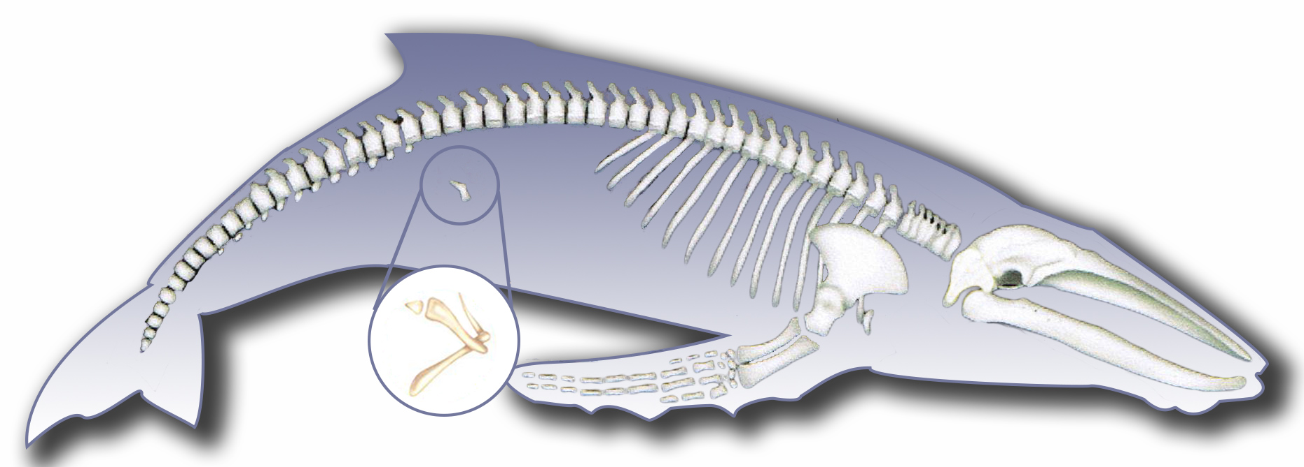
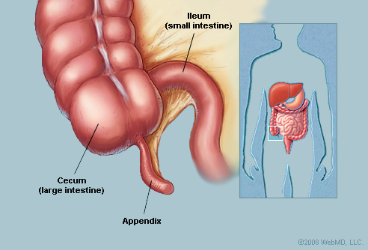
Indirect Evidences Vestigial Structures
Structures that once served a function but no longer serve that function but still remain in the organism because it has once used it.

Slide 14
Indirect Evidences - Physiological
The functioning of the chemicals in the body can be the same or different depending on the evolutionary history of the organisms.
- Insulin production in cows and injected in humans, does the same function, making them more related to each other than other organisms
Same type of waste is excreted from birds and reptiles making them more related to each other than to other organisms

Slide 15
Indirect Evidences – Biochemical
Comparison of the DNA molecules of organisms shows how closely they are related to one another.

Slide 16
Indirect Evidences – Biochemical

