Slide 1
Evolution
A Theory

Slide 2
So where did it begin?
Many scientists proposed theories that described the diversity of organisms
A few proposed that this diversity was due to organisms changing over time
Jean-Baptiste Lamarck
French Biologist, published the Theory of “Inheritance of acquired characteristics” in 1809
This was the theory that had bee proposed for over 2000 years from the time of Aristotle.

Slide 3
Inheritance of Acquired Characteristics
The theory that states “any physical changes that occur to an organism (acquired) may be passed to its offspring”
Also know as the theory of “Use and Disuse”: as an organism uses a characteristic more and more, it will be magnified as it will be passed down the generation, and as it does not use other feature, they will not get passed down to the next generation.

Slide 4
Inheritance of Acquired Characteristics

Slide 5
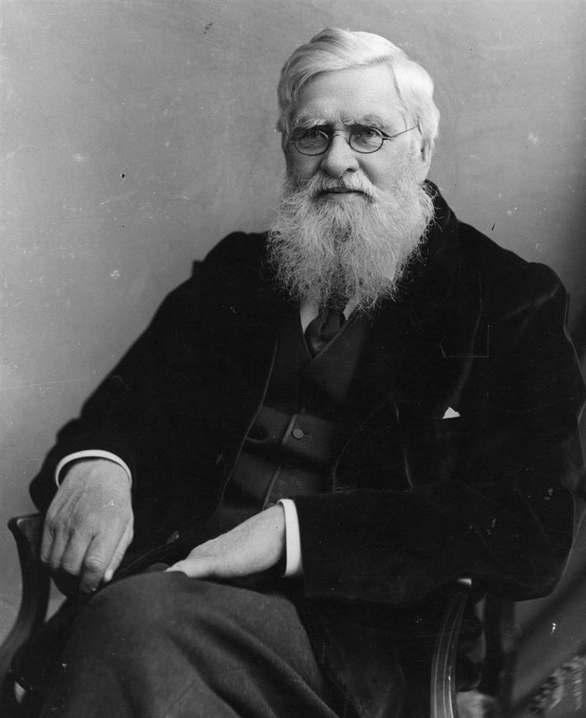
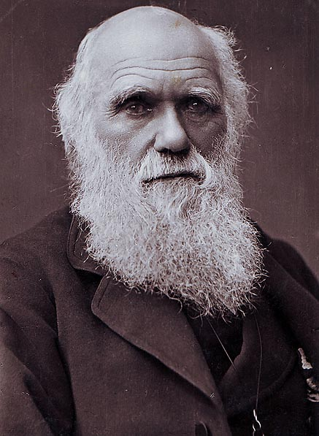
Theory of Evolution by Natural Selection
Charles Darwin
An English Naturalist/Geologist (1809-1882)
Alfred Wallace
An English Naturalist (1823-1913)
Simultaneously, they came up the the Theory of Natural Selection (Darwin just got more credit for it)

Slide 6
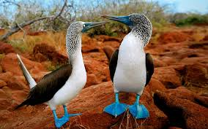
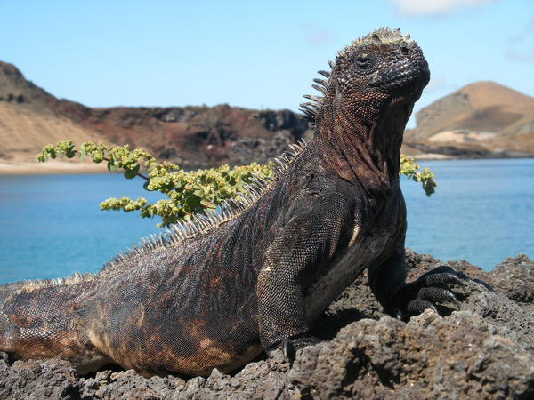
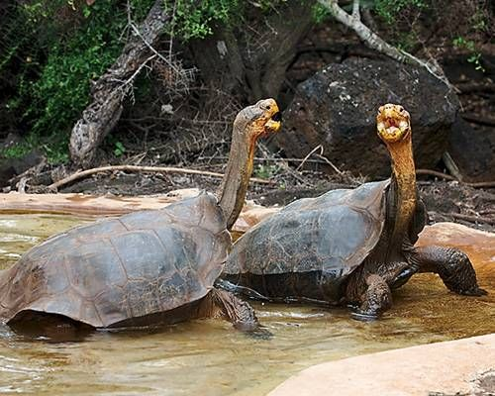
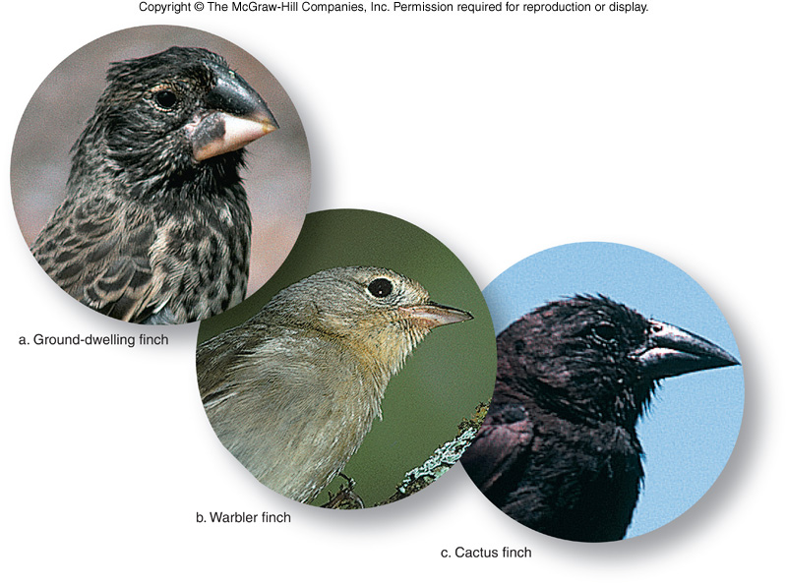
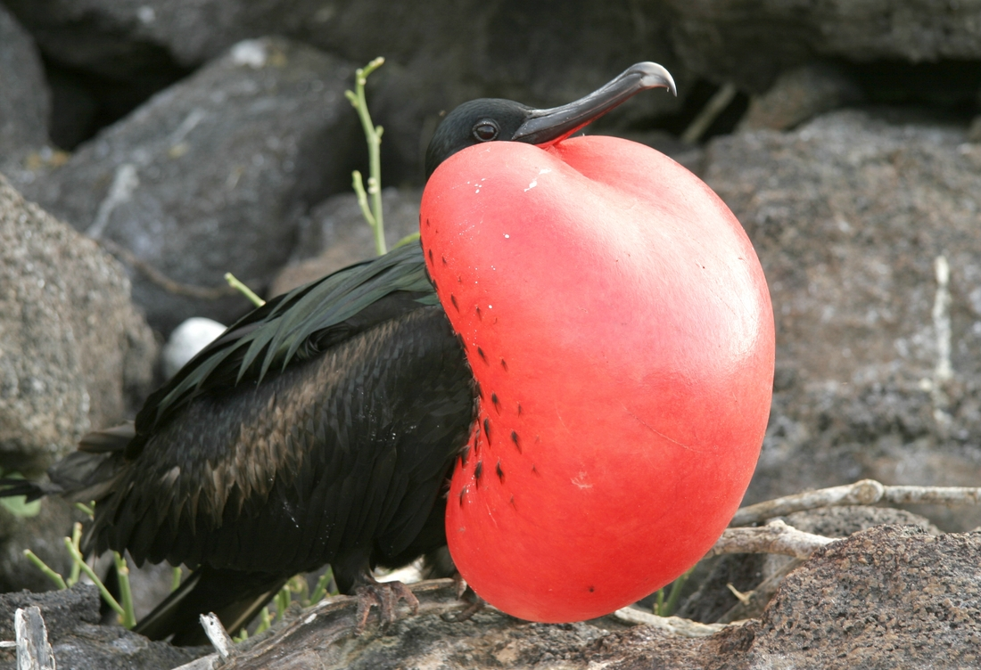
The Voyage of H.M.S. Beagle

Slide 7
Theory of Evolution by Natural Selection
Natural Selection: Process whereby organisms that are better adapted to their environment tend to survive and produce more offspring
5 Rules:
Overproduction
Inheritable Variation
Struggle for survival
Survival of the fittest
Origin of new species

Slide 8
5 Rules of Natural Selection
Overproduction:
More offspring are produced than can survive
Inheritable Variation:
There are differences in the offspring (diff colours/diff behaviours). These differences must be genetic and have the potential to be passed on to the offspring, otherwise they are irrelevant

Slide 9
5 Rules of Natural Selection
3. Struggle for survival:
Not all offspring are going to survive as they were overproduced… so some will live and others will die.
They have to compete with each other for the same resources
4. Survival of the fittest:
Those that are most suited to the environment will live and have more offspring than those that were not as well suited to their environment.
5. Origin of new species:
When the differences are so much so that the population becomes a new species.

Slide 10
Example: Giraffes
1. Overproduction: More baby “horse” were born than there are trees and shrubs for them all to eat.
2. Inheritable Variation: Some of these baby horses had a mutation which made their neck slightly longer/more flexible
3. Struggle for survival: Some of the babies will not get enough food and die, while others live
4. Survival of the fittest: Those babies which had slightly longer necks got more food, survived and had enough energy to produce more offspring than others. Their offspring also had longer necks.
5. Origin of new species: over generations, necks become longer and we no longer see them as horses, but as giraffes.

Slide 11
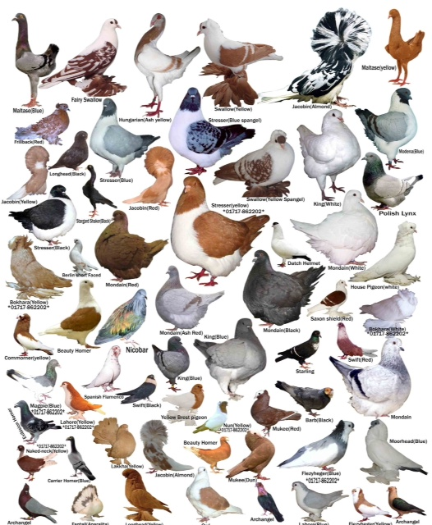
Artificial Selection

