Slide 1
Genetics of Evolution

Slide 2
The Genetic Code
All living things have a genetic code which they will pass on to their offspring. This is how Viruses, Bacteria, Fungi, Plants and Animals ensure their species continuity.

Slide 3
DNA
Deoxyribonucleic Acid
Double Helix – 2 parallel strands attached to each other
Made up of a Sugar-Phosphate backbone
Each Sugar is attached to a Nitrogen Base
Bases are Adenine(A), Thymine(T), Guanine(G), Cytosine(C)
A always pairs with T, G always pairs with C
One Phosphate-sugar-Base is called a nucleotide
a nucleotide has covalent bonds(shared electrons-very strong)
Base pairs A-T, C-G are attracted by hydrogen bonds
(positive-negative charge – weaker bond)

Slide 4
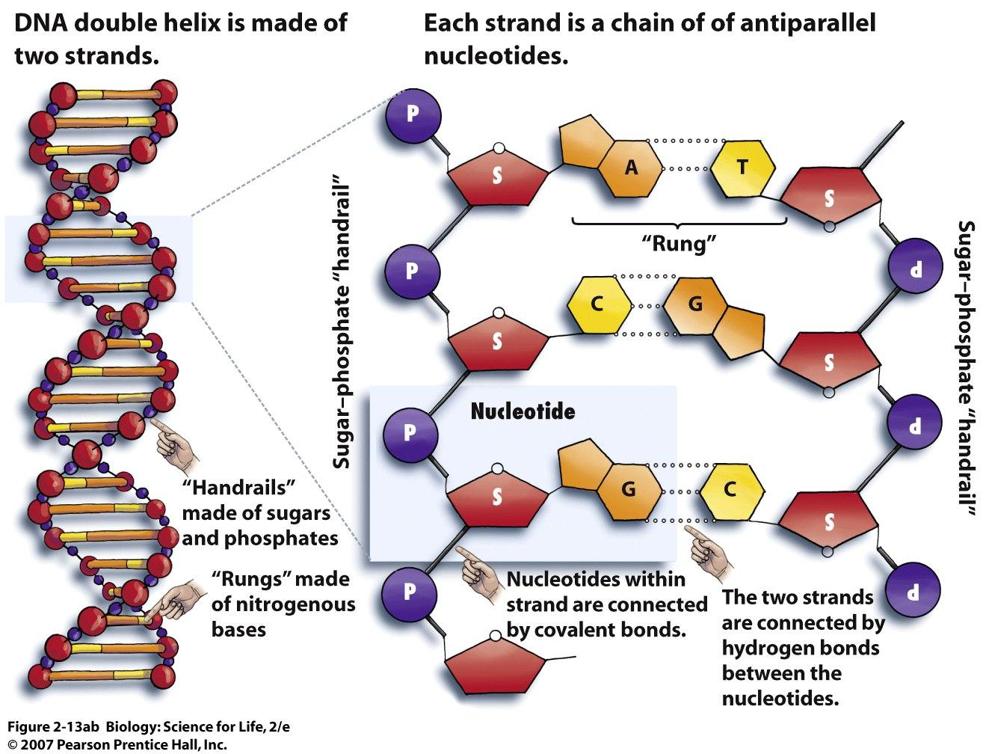
The DNA

Slide 5
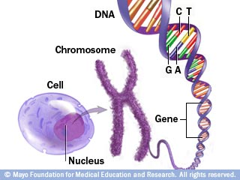
Genes
The Wrapped condensed form of DNA is called a chromosome
Organisms have varying number of chromosomes each made up of very long strands of DNA
A segment of the DNA is called a gene
Each gene has the code for a specific function in the cell/body of the organism

Slide 6
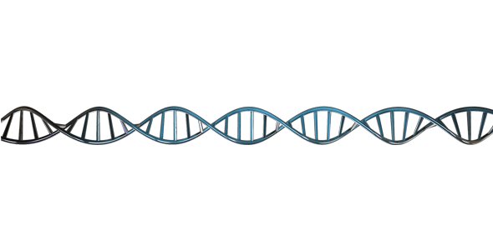
Genes and Alleles
Gene 1
Gene 2
Gene 3
Each gene codes for a specific structure/function
Each gene has different variants
Variants are determined by the order of AT,CG base pairs
Eg.eye colour – blue, brown, green
Each variant of the same gene is called an allele
Eg. The brown allele, the blue allele, the green allele for the eye colour gene
Genes can code individually or in combination with other genes.
How tall someone is can be determined by several genes for hormone release, bone and muscle growth genes etc.

Slide 7
Genes and Alleles
Most organisms get 2 sets of the same genes- one from the father and one from the mother.
Each set can have different alleles.
Eg. Mom’s gene for eye colour might be blue while the father’s gene for eye colour is brown
Alleles can be
Dominant or Recessive
Dominant allele will always “mask” recessive allele
Dominant written as capital letters (B – black hair)
Recessive written as lower case letters (b – for red hair)

Slide 8
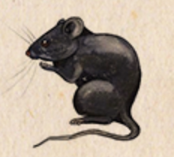
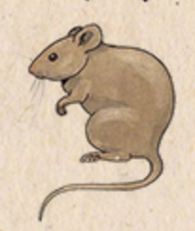
Phenotype Vs. Genotype
Genotype is the genes that the organism possesses
Phenotype is what the organism looks like as the result of the genes
Dominant – Black (B)
Recessive – Brown (b)
black from mom, black from dad – BB = Black
black from mom, brown from dad – Bb = Black
Brown from mom, brown from dad – bb= Brown

Slide 9
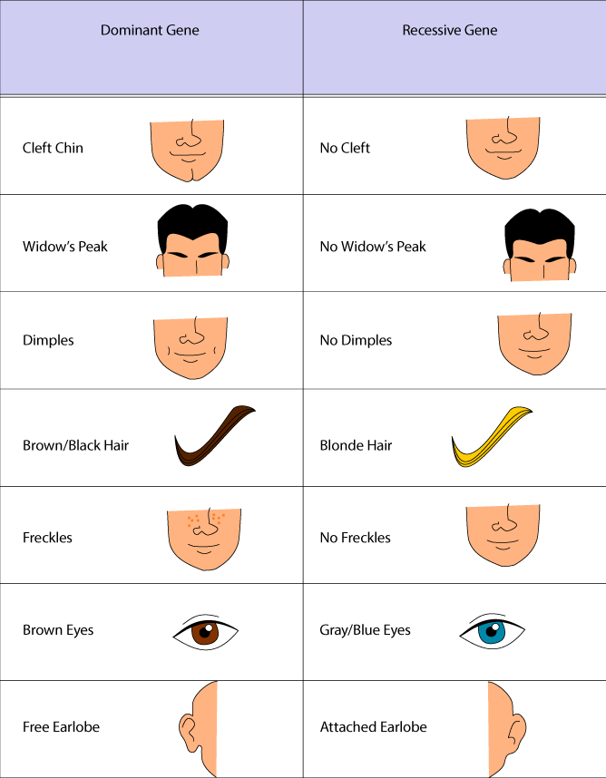

Slide 10
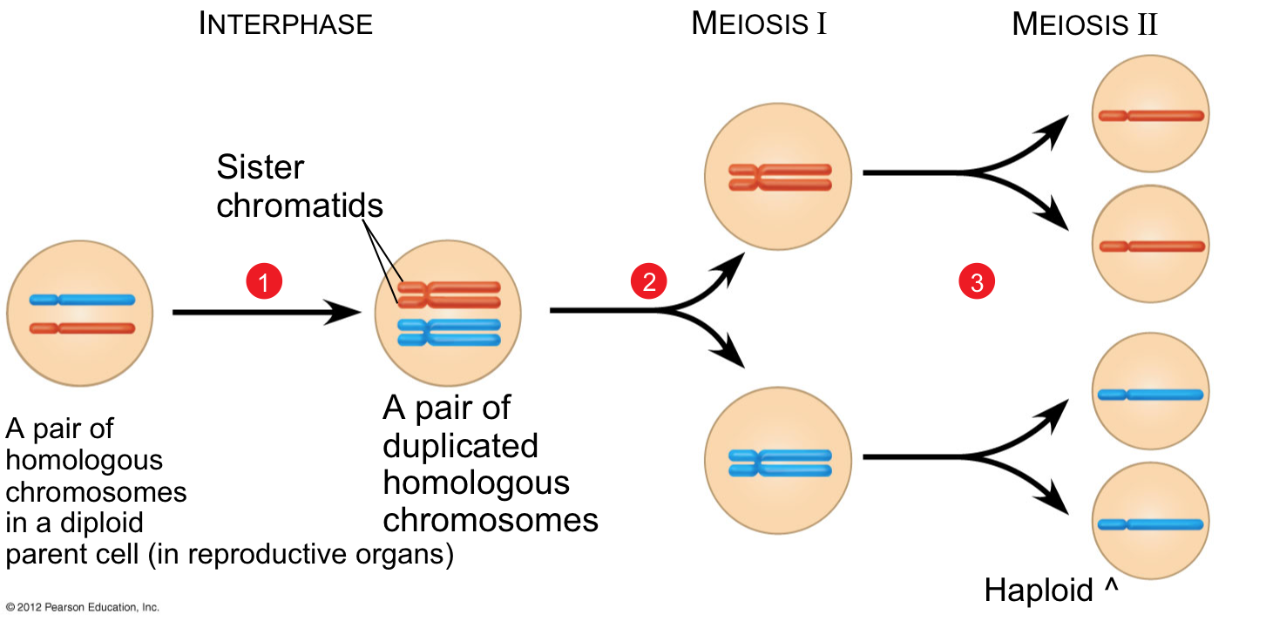
Sex - Meiosis
Organisms get their DNA/genes from mom and dad
Each parent has 2 sets of DNA (diploid), gametes(egg/sperm) have 1 set of DNA (haploid)

Slide 11
Sex
Punnett Squares – diagram that is used to predict an outcome of a particular cross or breeding
Homozygous:
Same allele
Heterozygous:
Different allele
Phenotype: Brown
Genotype: bb
b
b
Phenotype: Black
Genotype: BB
B
b
B
B
b
B
b
B
B
b

Slide 12
Punnett Squares
Phynotype:
Black
Genotype:
Bb
Phynotype:
Black
Genotype:
Bb
Phynotype:
Black
Genotype:
BB
Phynotype:
Black
Genotype:
Bb
Phynotype:
Black
Genotype:
Bb
Phynotype:
Brown
Genotype:
Phynotype:
Brown
Genotype:
Phynotype:
Brown
Genotype:

