Slide 1
How to Learn at Home (online)
Suggestions to keep yourself from being overwhelmed
Notes:
The following are some ideas to help you manage your online learning at home.
These are just suggestions that you may find helpful to fully use or use parts of it or modify it to suite your needs.
Learning at home and getting instructions online may be fun for some people but for others it can be quite overwhelming and disconnected.
It’s not magic to change all the habits you used to have and to disconnect from the people you used to hang out with all the time. It is a process and it’ll take time.
Here are some things to think about when trying to manage your learning at home and online.
DISCLAIMER – this may not work for you, but if you can take elements of it and use it, then you can be more productive and less overwhelmed.

Slide 2
Break Down The Elements
Physical Environment
The physical space
Time management & Motivation
Routines and tools to help productivity of each day
Organization
Tools to keep on top of due dates and electronic communication

Slide 3
Physical Environment
Set up a SPACE
Physical Space – clear of clutter
Tell family members about this space
Space should feel safe and prepared for work
Keep Distractions away
Make- Shift space
Make temporary space available for a period of the day
Notes:
Physical Environment
Set up a physical space at home that is designated for school work
Try to have the space away from family activities
Have the space decluttered from non-essential things
Keep any distractions away from this space
When you enter this space you should feel safe and focused.
Troubleshoot (if you don’t have this space available in your house)
Can there be a make-shift space? For example, can your dining room table or a corner of your house where there is any table be used certain times of the day? You can move your school things in the space for a period of time then pack up after you’re done.
If there are family activities or siblings, who disturb this space, can you have a talk with your family to see what time of the day that space can be yours to use? -Even if it’s for 30min/day.

Slide 4
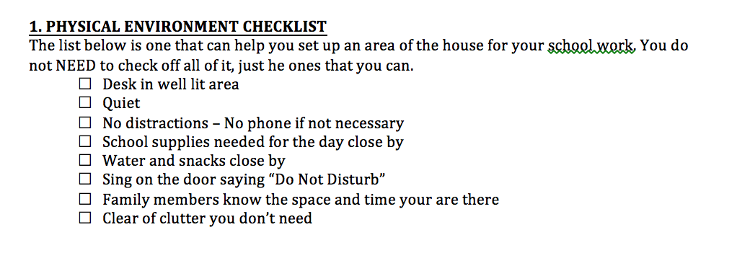

Slide 5
Time Management & Motivation
Set up a routine for your day
Realistic to your life and your family’s life
Healthy for the body, mind and soul
Productivity in mind
Have major and important activities planned first
Break up with breaks that nourish the mind, body and soul
Take a Chill pill
Not everything is about school
Do things that you enjoy doing every day
Notes:
Time management & Motivation
ROUTINE – get one!
Set up a daily routine at least for the weekdays.
Set up alarm daily in the morning (a time that is realistic for you)
Have breakfast
Go for a walk if you like/check your social media if you like
(DO NOT engage in activities, which drain your energy or require your attention for the next few hours – ex. DO NOT go for an intense run, if you know that you’re going to need a nap after, DO NOT start conversations on social media that require you to respond constantly – END all activities that require your attention)
School time – Prioritize which subject and which assignment you’re going to do (see “Organization” below for help on that)
Spend enough time to have a good portion of the assignment done and take a 5 min break when you need it, don’t lie to yourself – you know best when you actually NEED a break
Lunch – Eat something healthy whenever you have the opportunity to
Do something active – something that moves your body
Walk/jog/yoga/garden/shoot hoops/sports with siblings
Connect with family and friends – tell people that it’s your lunch break and talk to them – in person or electronic, check your social media – post something positive about your day
Have a nap if you need one, but set an alarm – multiples of 20min naps are best to my experience
Lunch break is to nourish your body and your mind, do something that refreshes you
School time – Cut all distractions and continue your work for as long as you can with breaks when you need them.
Relax time – do WHATEVER you want! YOU DESERVE IT! You set up a schedule and stuck to it! Do whatever you need to enjoy your day
Be aware of your body/mind/soul needs – Are you hungry/thirsty? Is your mind tired? Do you need something mindless to do - A stupid game on your phone? Does your body need to move? Are your muscles sore or stiff? Do you need to lye down? Do you need social connection? Do you need to talk to someone? Do you need to meditate? Would music cheer you up? Have a dance party in your head or out physically? Don’t ignore your body, mind and soul.
Evening activities – spend time with family and yourself if you prefer
Cook something – From fried eggs to 3 course meal
Pick up a new hobby – is there anything you’ve always wanted to do, but never had the time to?
Play board games with family
Watch a new show
Reflect on the day – ALWAYS look back at what you did during the day – pick 2 things that you are proud you did and 1 thing that you would like to change tomorrow.
Set up a nightly routine – exclude the phone screen close to bed time – read a new book, start or continue writing in a diary.
SLEEP at a reasonable time – if you don’t get enough sleep you will have a hard time keeping up with tomorrow’s schedule

Slide 6
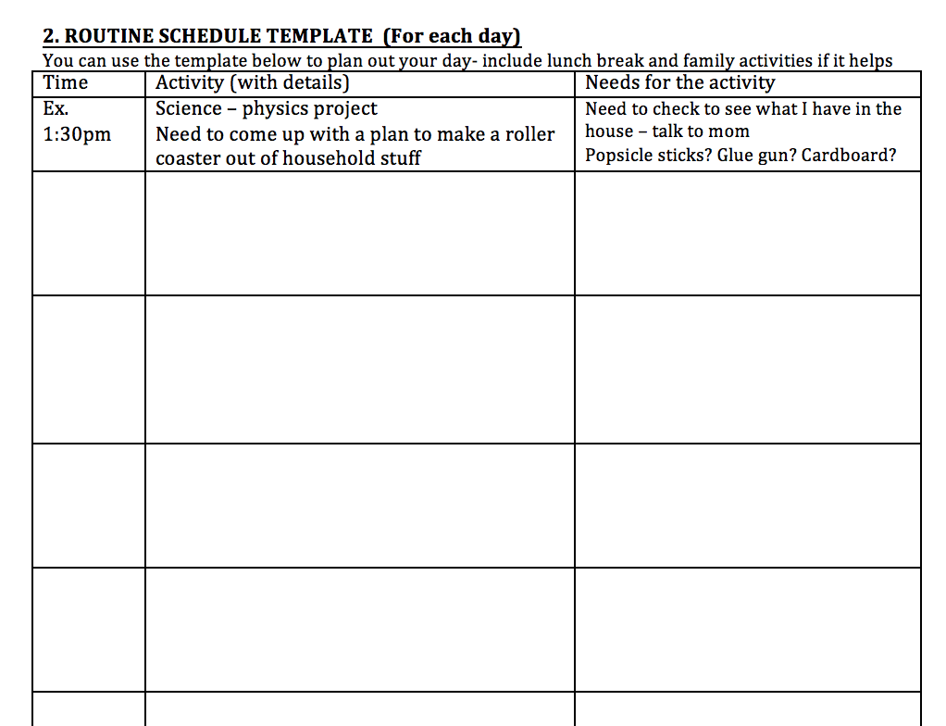

Slide 7
Organization
Use visual calendars and checklists
Electronic or paper
Realistic and practical
Communication
How do you communicate with teachers and classmates?
How do you organize your communication?
Notes:
What mode of VISUAL organization works for you? If you don’t know, you NEED to try different things …. like… yesterday.. ASAP!
You need a calendar
print off the internet (just google “2020 calendar blank”)
Blank notebook with each page as one day just label each
A paper calendar you already have in the house
Your computer calendar
Your phone’s calendar
You need to put all assignment due dates, test, quiz days on it
You need an course list with contacts (see below for sample)
Which course, with which teacher, what’s their email, how do I submit assignment
You should organize your email inbox
Create folders within your inbox with your course name and put all emails from each teacher in the proper folder
Check your email daily – even twice a day to keep on top of all emails
Have a checklist – paper or on your phone
What have you done and what do you need to do next?
Checking off things you’ve done will motivate you to get more things done

Slide 8
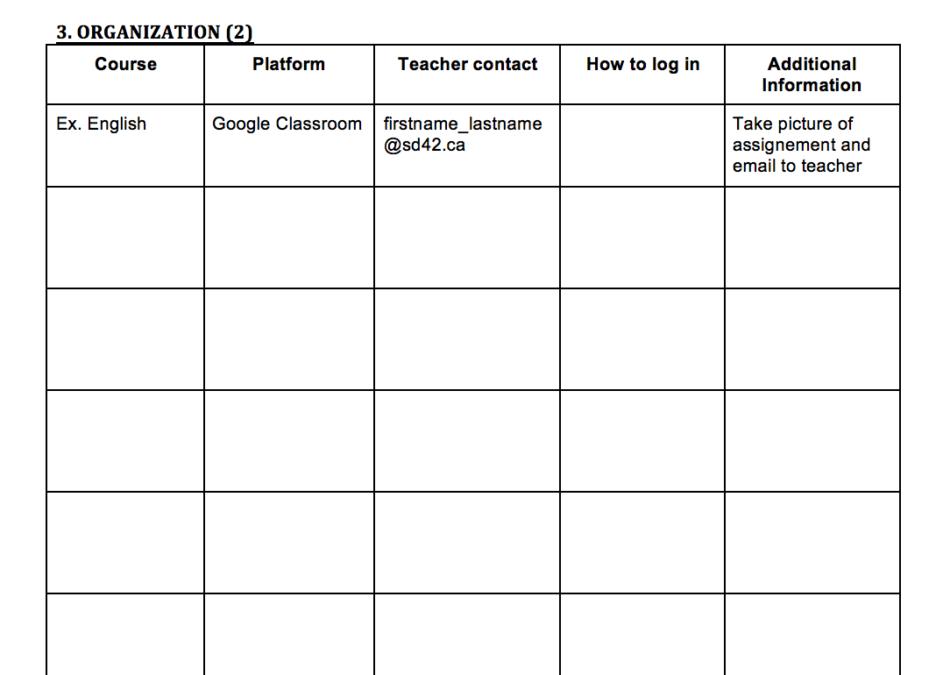

Slide 9
