Slide 1
Phylum Porifera
Sponges

Slide 2
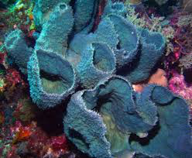
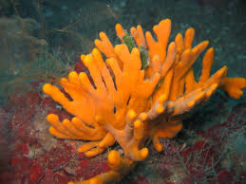
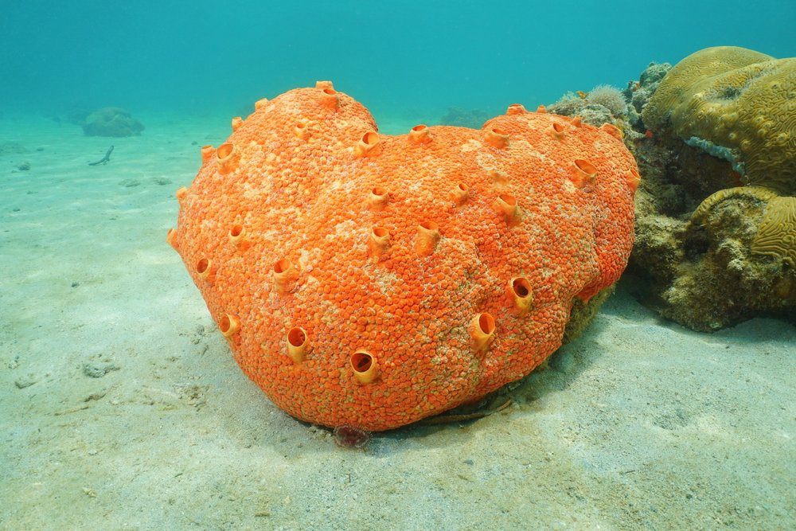
What are they?
________________________________
________________________________
________________________________
________________________________
________________________________
________________________________
________________________________
________________________________
________________________________
________________________________

Slide 3
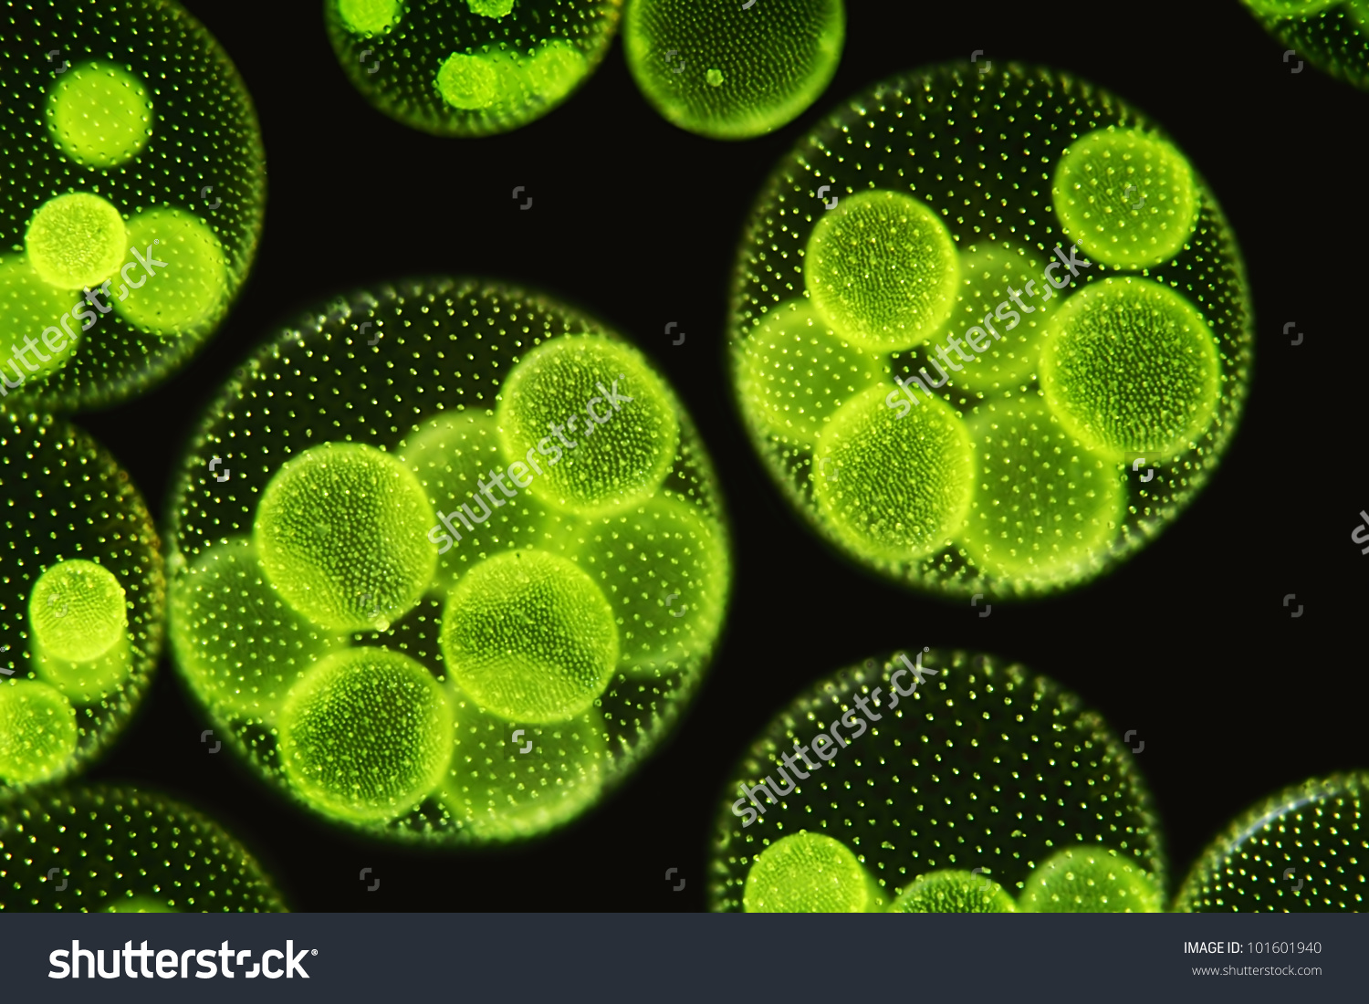
Cell Organization
__________________________________________________
__________________________________________________
__________________________________________________
__________________________________________________

Slide 4
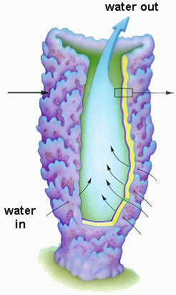
Body Plan
______________
___________________
___________________
______________

Slide 5
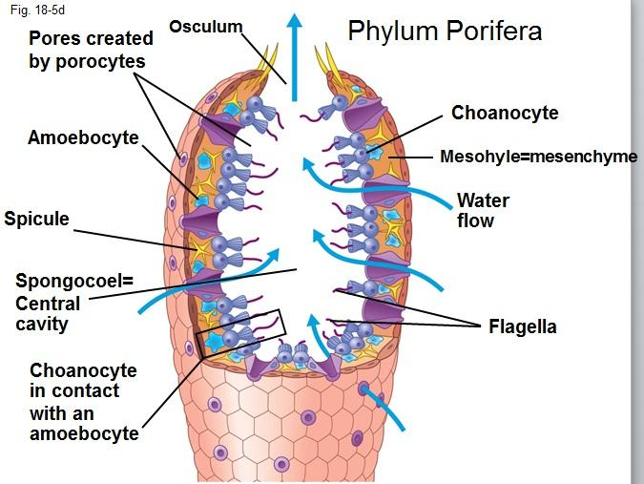
Body Plan - Parts

Slide 6
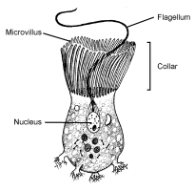
Body Plan – Types of cells
______________________-
Cells lining the ______________ of the sponge – they have ___________, which whip the ___________into a __________ from ___________ the sponge to the _________of the sponge. They also __________________ using their ___________

Slide 7
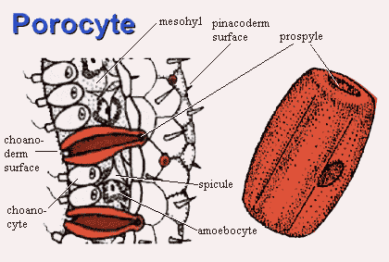
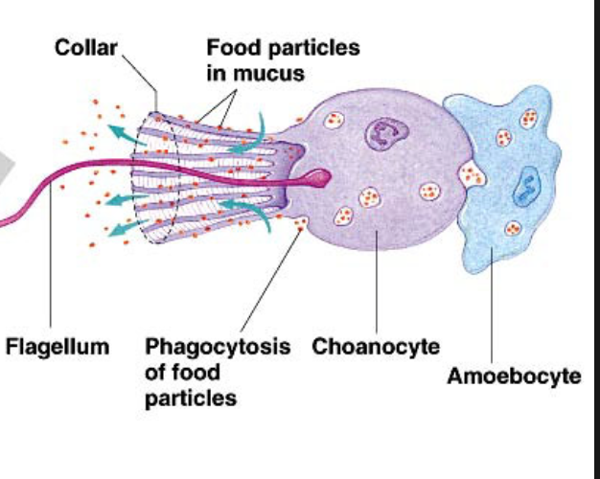
Body Plan – Types of cells
________________- Cells which are__________that connect the outside of the sponge to the inner cavity _____________________.
_______________- moving cells inside the sponge tissue, which ___________ to various types of other cells and _______________ from one cell to another.

Slide 8
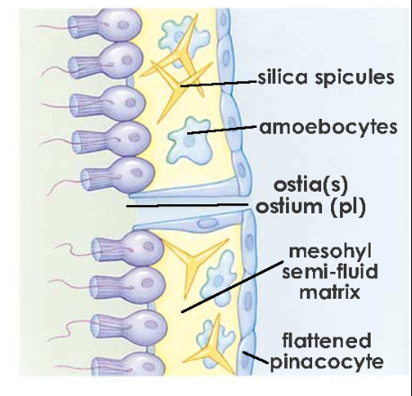
Body Plan – Types of cells
_________________- forms the _____________ of the sponge tissue
_________________ – secretes ____________to produce spicules
_______________– give support to the sponge

Slide 9
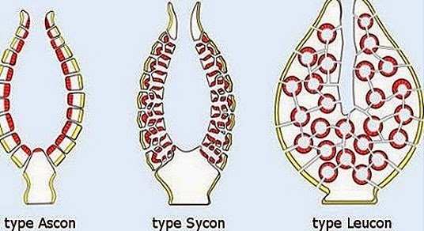
Water Canal System
___________________ whip their _____________creating a ____________ pulling water in from the ___________ (porocytes) toward the ______________ (songocoel) and out of the ___________.

Slide 10
Respiratory “System”
________________________________________________________________________________
________________________________________
________________________________________
Digestive “System”
________________________________________________________________________________
________________________________________
________________________________________

Slide 11
Circulatory “System”
________________________________________________________________________________
________________________________________
________________________________________
Nervous “System”
________________________________________________________________________________
________________________________________
________________________________________

Slide 12
Reproductive “System”
________________________________________________________________________________
________________________________________
________________________________________

