Slide 1
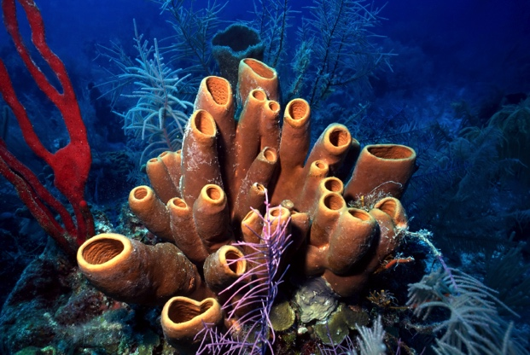
Phylum Porifera
Sponges

Slide 2
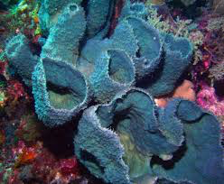
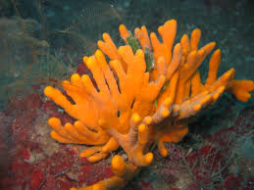
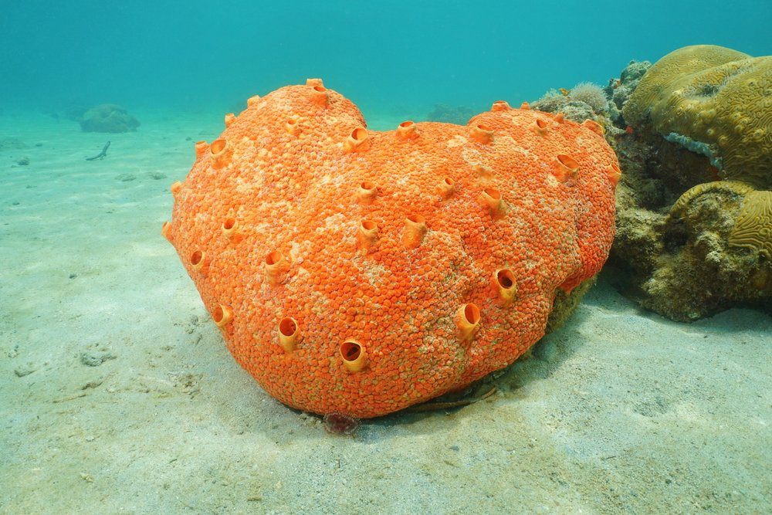
What are they?
Porifera = “pore bearer”
Sponges
The most basic multicellular animals
Hard bodied or soft bodied
Only aquatic (why?)
Asymmetrical body
Variety of colours, shapes, sizes
Sessile (don’t move)

Slide 3
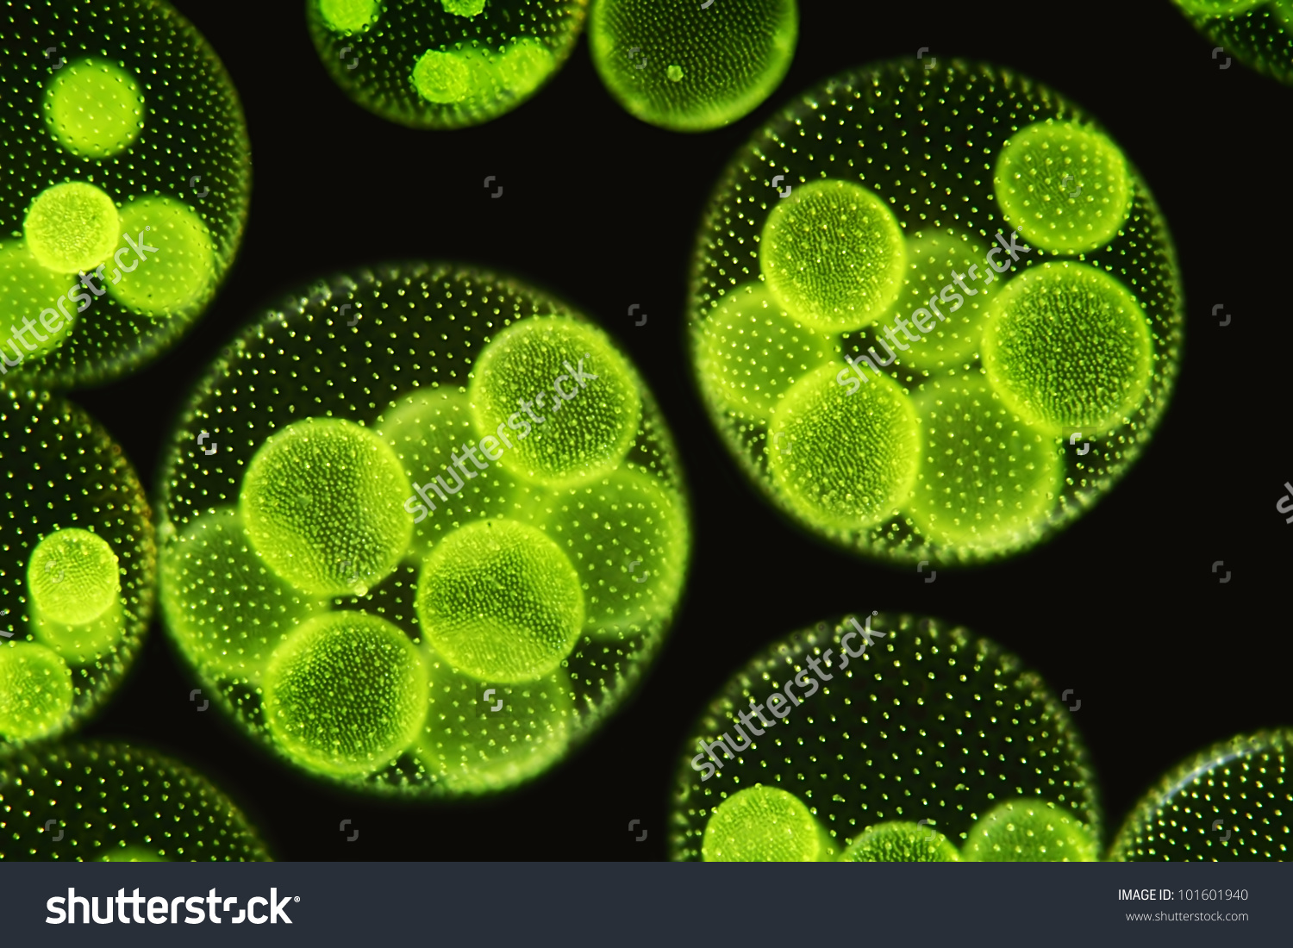
Cell Organization
Believed to evolve from a colonizing protist – Volvox
Multicellular – more than one cell, specialized/differentiated cells…
BUT, No tissues, No organs, No systems
Most simple animal (what makes an animal an animal?)

Slide 4
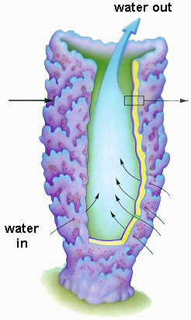
Body Plan
Osculum
Central Cavity
(Spongocoel)
Ostia

Slide 5
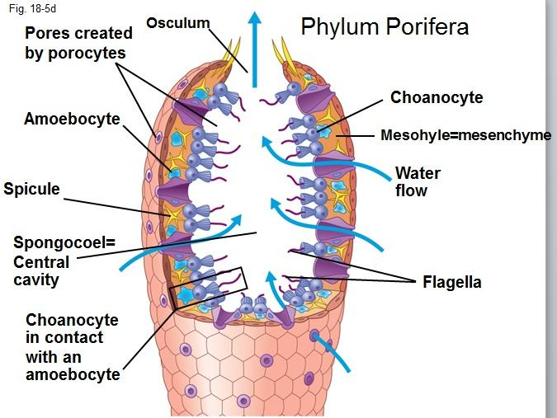
Body Plan - Parts

Slide 6
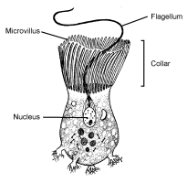
Body Plan – Types of cells
Choanocyte (collar cells)- Cells lining the the inside of the sponge – they have flagella which whips the water into a current from outside the sponge to the inside of the sponge. They also trap food particles using their cilia

Slide 7
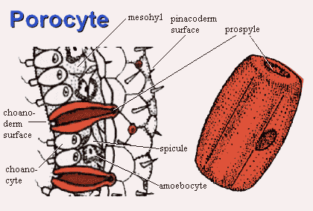
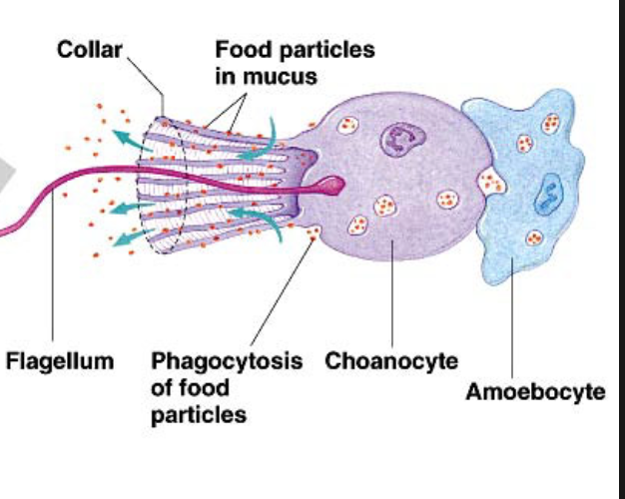
Body Plan – Types of cells
Porocyte- Cells which are channels that connect the outside of the sponge to the inner cavity allowing water in.
Amoebocyte- moving cells inside the sponge tissue, which give rise to various types of other cells and deliver nutrients from one cell to another.

Slide 8
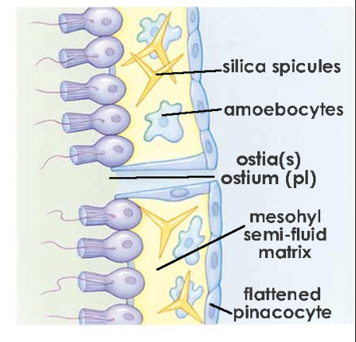
Body Plan – Types of cells
Pinacocyte – forms the outer layer of the sponge tissue
Sclerocyte – secretes silica to produce spicules
Spicules – give support to the sponge

Slide 9
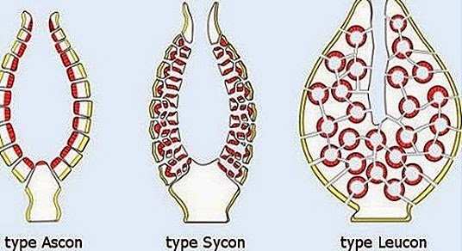
Water Canal System
Choanocytes whip their flagella creating a current pulling water in from the ostia (porocytes) toward the central cavity (songocoel) and out of the osculum.

Slide 10
Respiratory “System”
Diffusion – Since the sponge is constantly pumped with water through the water canal system, oxygen diffuses into the cells and carbon dioxide diffuses out of the cells
Digestive “System”
Food sticks to the inside of the canals, cells digest the food. Most food is captured by cilia of collar cells. Food transported by amoebocytes

Slide 11
Circulatory “System”
Amoebocytes are the only moving cells which transport mainly food from cell to cell
Nervous “System”
Absent. No coordination. No Nerve communication between cells. (If you break off a part of the sponge, the other parts won’t know about it)

Slide 12
Reproductive “system”
Sexual
Special cells in the male sponge produce sperm which is released and swims to the eggs produced on Oocytes on the female sponge. The fertilized egg is then released in the current where it travels and finally settles and starts a new sponge.
Asexual
Break a piece off and it will grow a new sponge.

