Slide 1
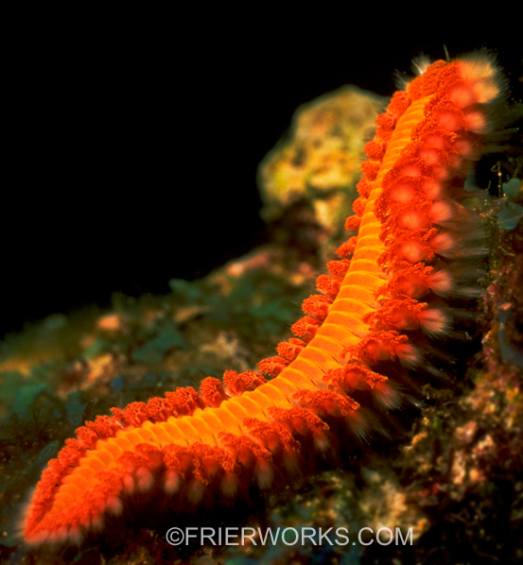
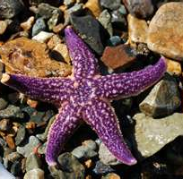
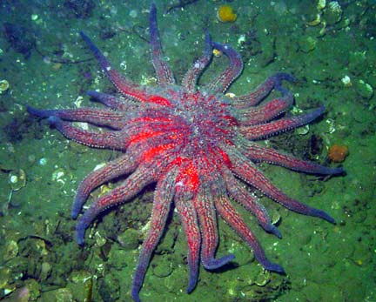
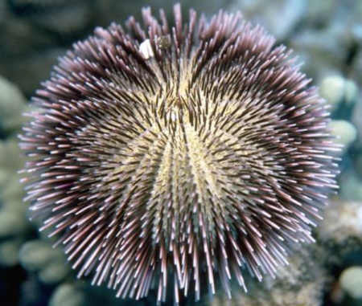
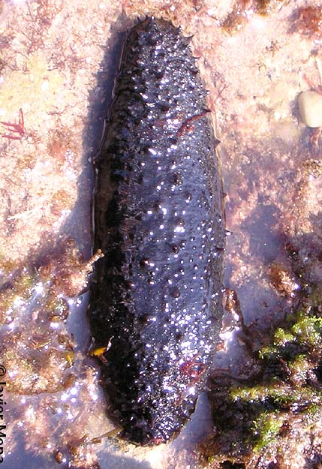
Phylum Echinodermata

Slide 2
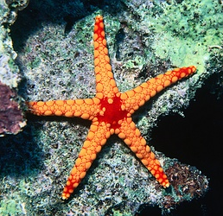
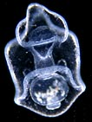
Echinoderms
Name means spiny skin
Have pentaradial symmetry
Larvae have bilateral symmetry
egg development and larva similar to chordates → common ancestor?
Coelomate
Strong regeneration capabilities
Water Vascular System

Slide 3
Evolutionary Advances
Water vascular system
found only in echinoderms
water filled tubular hydraulic system attached to the tube feet
used in movement, feeding, respiration, circulation and excretion
opens to the outside via the Madreporite
Water to enters the Madreporite and flows through the Stone canal, Ring canal, Radial canals in each arm before branching into a structure consisting of a bulb-like ampulla and tube foot

Slide 4
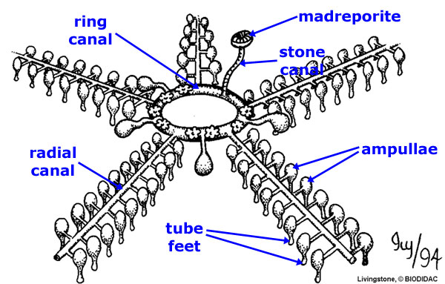
Water Vascular System
Movement of water into and out of the tube foot creates a suction-cup like action which allows the echinoderm to attach to a surface
all echinoderms walk with their tube feet, some use them for feeding

Slide 5
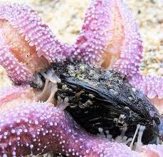
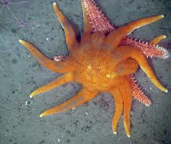
Systems
Feeding
Carnivores
Ex. seastars
use their tube feet to pry open the shells of bivalve mollusks
then flips the stomach out of it’s mouth
pours out enzymes, and digests it’s prey in its own shell
pulls the stomach back, leaving an empty shell
Sunstar feeds on other seastars

Slide 6
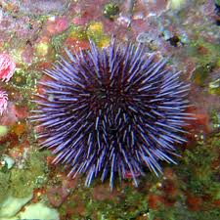
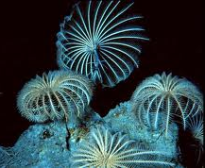
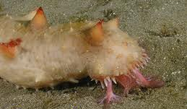
Systems
Feeding
Herbivores
Ex. sea urchins
scrape algae from rocks
Filter feeders
Ex. sea lilies, basket stars, etc.
use tube feet on flexible arms to capture plankton that float by on ocean currents
Detritus feeders
Ex. sea cucumbers
move much like a bulldozer
take in a mixture of sand and detritus

Slide 7
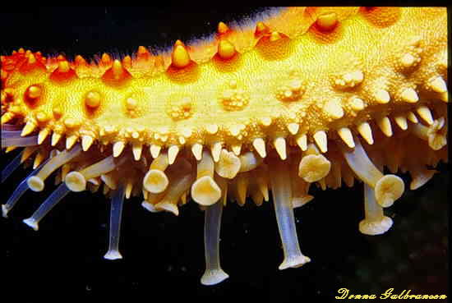
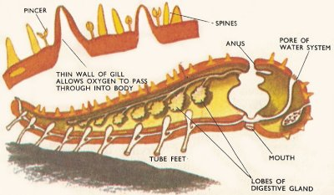
Systems
Respiration
Gas exchange occurs at the tube feet
in some species, small outgrowths called skin gills also function in gas exchange

Slide 8
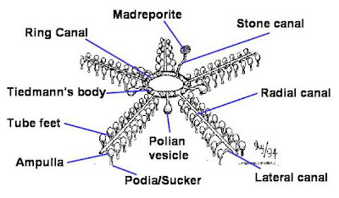
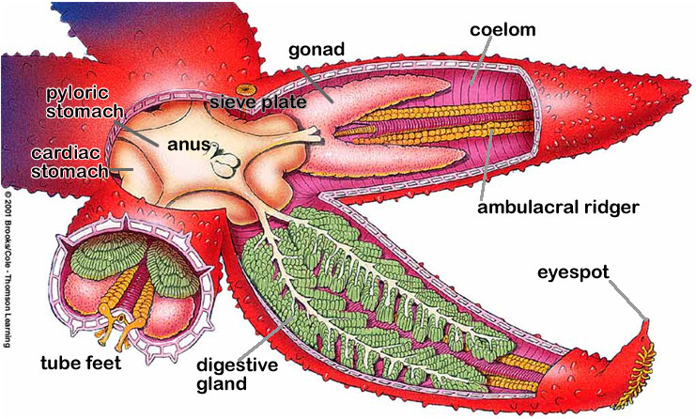
Systems
Internal Transport
Movement of Gases and wastes performed by the Water Vascular System and Coelom
Nutrients distributed by the Digestive gland

Slide 9
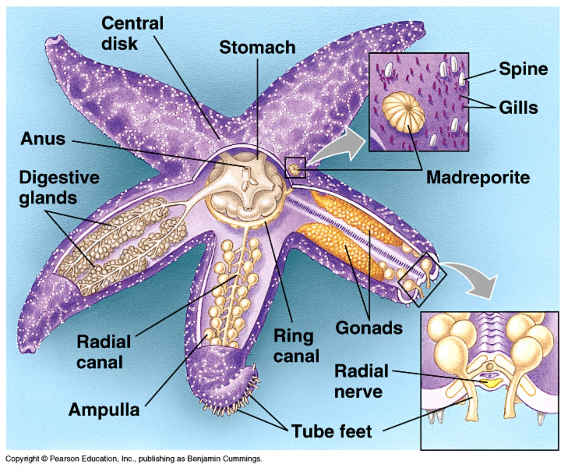
Systems
Excretion
Metabolic wastes are expelled by the tube feet and skin gills

Slide 10
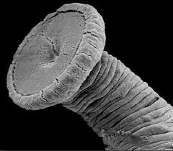
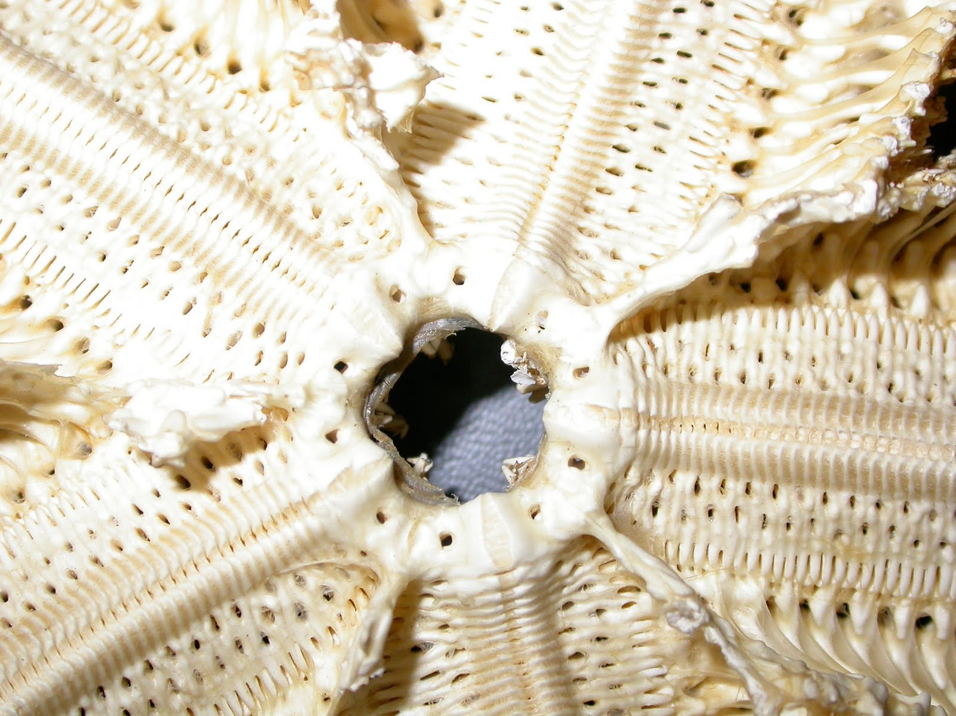
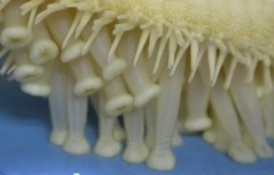
Systems
Movement
Endoskeleton made up of ossicles
Reduced in sea cucumbers
Use tube feet and thin layers of muscle fibers attached to the plates of the endoskeleton to move
Pedicellaria – pinchers on the skin for protection

Slide 11
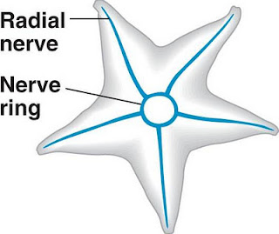
Systems
Response
Primitive nervous systems
No head
Scattered sensory cells
eyespots at the tip of each arm
statocysts for balance

Slide 12
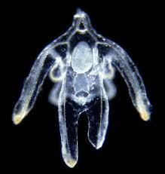
Systems
Reproduction
Most echinoderms have separate sexes
Some are hermaphrodites
External fertilization
Larvae have bilateral symmetry
Strong regenerative abilities

Slide 13
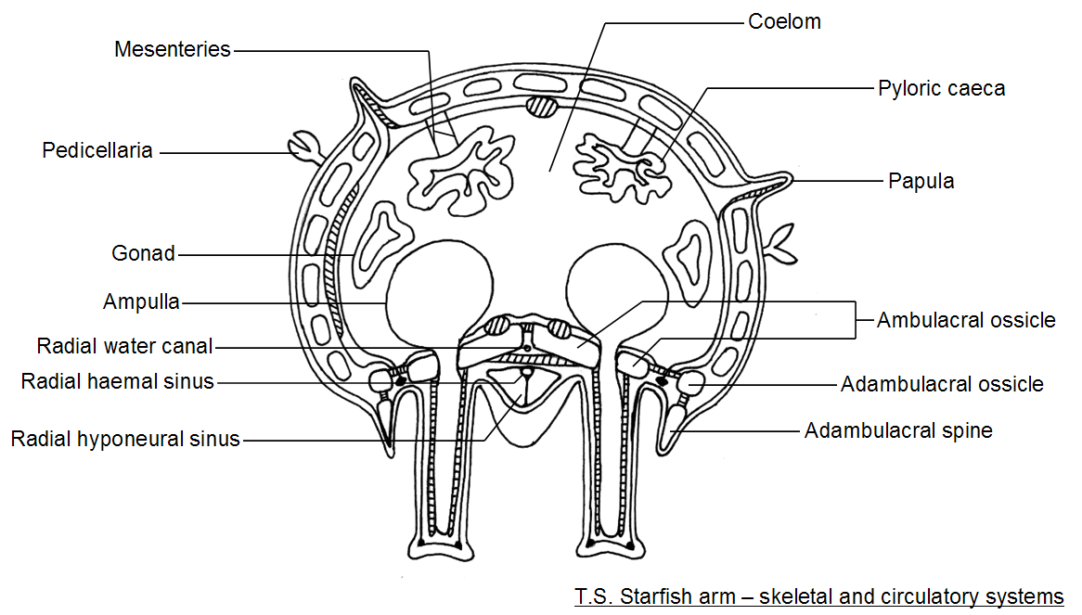

Slide 14
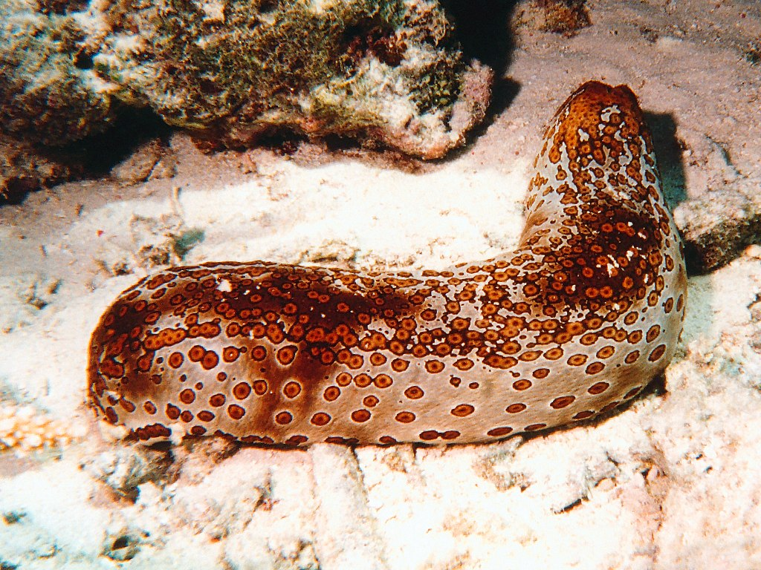
Ecology
Important in controlling populations
Ex. Sea urchins control algae
Sea cucumber known as the oceans vacuum cleaner

Slide 15
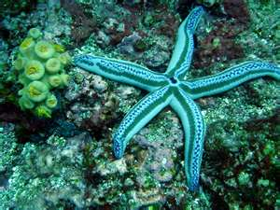
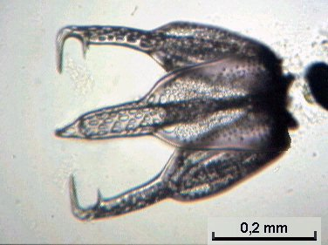
Organization
5 Classes
Class Asteroidea:
seastars
star-shaped bottom dwellers
carnivorous
endoskeleton of Calcium carbonate ossicles
pedicellaria (pinchers) on skin for protection
Eversible stomach

Slide 16
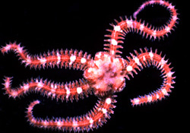
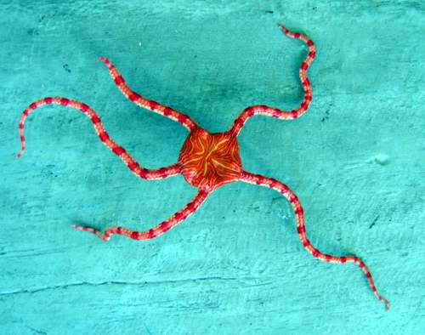
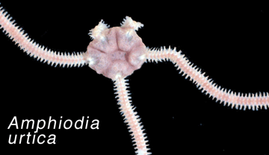
Organization
Class Ophiuroidea
brittle star
small body disk
long thin arms
lack anus
mostly filter feeders or detritus feeders
key characteristic
arms break off easily

Slide 17
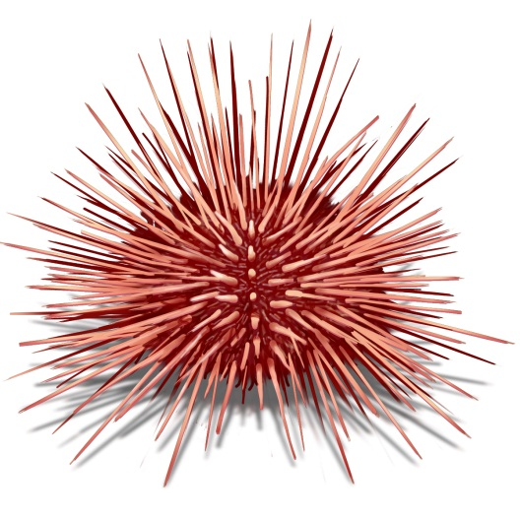
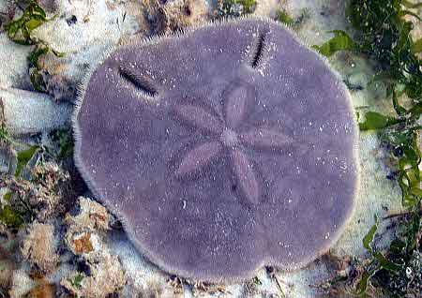
Organization
Class Echinoidea
Sea urchins and Sand dollars
No arms
body covered in spines or hard covering
mostly herbivorous or detritus feeders
5 bands of muscles

Slide 18
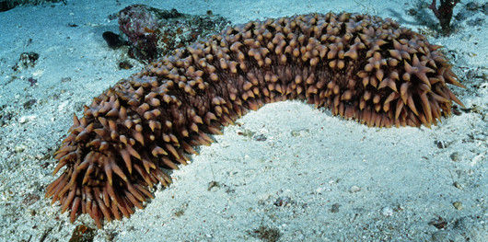
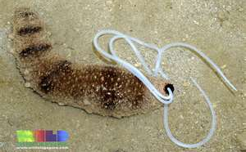
Organization
Class Holothuroidea
Sea cucumbers
Cylindrical body with feeding tentacles at one end
Mostly detritus of filter feeders
Endoskeleton reduced
Key characteristic
able to expel its internal organs

Slide 19
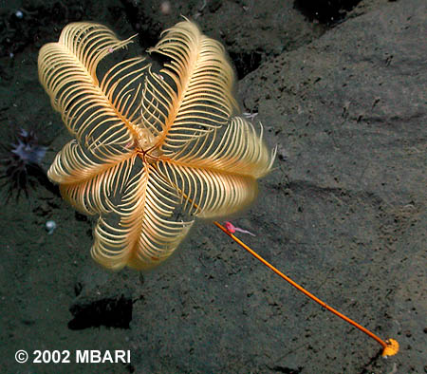
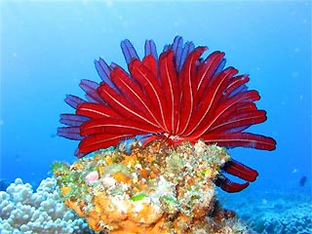
Organization
Class Crinoidea
Sea lilies or Feather stars
Filter feeders
Arms modified to filter food from the water
Mouth and anus on upper surface

